Slide 1
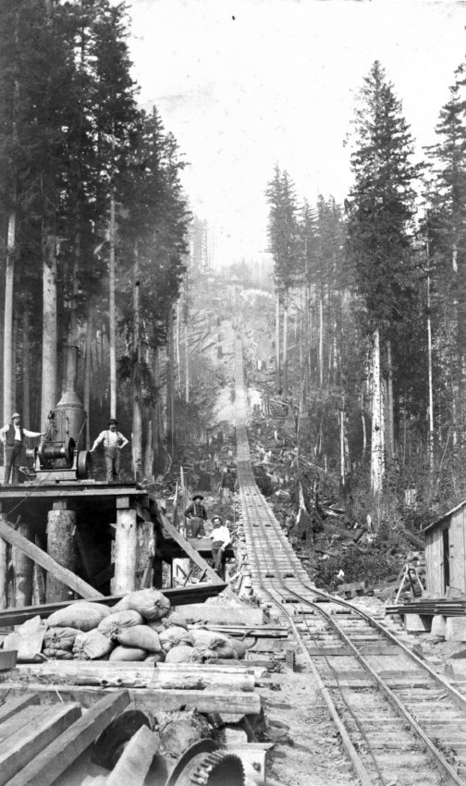
GRADE 4 · WASHINGTON STATE SOCIAL STUDIES
A Local History
of the Eastside
Lesson 1 · Stumps, Shingles, and Steel
Lesson 2 · Strawberries, Shipyards, and Software
Logging railroad, Eastside, c. 1885. Eastside Heritage Center.
Notes:
[CORE] · FRONT MATTER · about 1 min
KEY POINTS
A two-lesson unit built for 45-minute blocks, with an optional field-study day.
Geographic emphasis: Redmond and Kirkland carry most of the lesson time, named individuals, and site studies; Bellevue appears through its Japanese American farming community and postwar growth; Sammamish through the plateau's mill towns, its rural persistence, and its 1999 incorporation.
Every slide after this one carries a CORE or ADDITIONAL badge in the title band. A teacher running short can drop every ADDITIONAL slide and still meet every listed standard.
HOW TO TEACH IT
Introduce the unit in one breath: this is history that happened where students live, and the point is to notice how much the ground under them has changed jobs. Name the two lesson titles and move on.
For reviewers: the badge system replaces the earlier note-only tagging. CORE slides are the spine; ADDITIONAL slides (Early Businesses, The lake drops nine feet, Derby Days, Redmond by the numbers) add texture and can be cut without losing a standard.
STANDARDS · GRADE 4
Framing slide; no standard is assessed here.

Slide 2
Standards covered in this unit
CORE
H1.4.2 Examine how the following themes and developments help to define eras in Washington state history since time immemorial to 1889.
H2.4.1 Analyze and explain how individuals have caused change in Washington state history.
H2.4.2 Analyze and explain how people from various cultural and ethnic groups have shaped Washington state history.
H2.4.3 Analyze and explain how technology and ideas have affected the way people live and change their values, beliefs, and attitudes in Washington.
H3.4.1 Explain why individuals and groups in Washington state history differed in their perspectives.
H3.4.4 Describe how people's perspectives shaped the historical sources they created.
H4.4.1 Recognize and explain significant historical events in Washington state that have implications for current decisions.
C1.4.4 Describe and apply the key ideals of unity and diversity within the context of the State of Washington.
C2.4.1 Distinguish the responsibilities and power of state, local, and tribal government.
C3.4.1 Recognize that tribes have lived in North America since time immemorial.
C4.4.2 Analyze and evaluate ways of influencing state governments to establish or preserve individual rights and promote the common good.
E1.4.1 Analyze and explain the costs and benefits of people's decisions to move and relocate to meet their needs and wants.
E2.4.2 Identify the basic elements of Washington state's economic system, including agriculture, businesses, industry, natural resources, and labor.
E4.4.1 Explain how geography, natural resources, climate, and available labor contributed to the exploitation of resources in the Pacific Northwest.
E4.4.2 Explain the economic issues that different communities within the Pacific Northwest faced.
E4.4.3 Explain how trade led to increasing economic interdependence among groups within the Pacific Northwest.
SSS1.4.2 Evaluate primary and secondary sources.
SSS3.4.1 Draw on disciplinary concepts to explain the challenges people have faced and opportunities they have created in addressing local, regional, and global problems at various times and places.
RCW 28A.320.170 Tribal history and culture (Since Time Immemorial) · RCW 28A.345.130 Inclusive instructional materials.
2
Notes:
[CORE] · FRONT MATTER · not timed
KEY POINTS
A transparency slide for reviewers; it does not need to be shown to students.
Placed at the front so alignment can be verified before reading a single content slide. The where-and-how detail is in the companion document.
The Since Time Immemorial foundation slide anchors the tribal-history requirement but does not complete it: this unit supplements the district's standalone STI instruction, it does not replace it.
HOW TO TEACH IT
Skip in class. If an observer is present, leave it up for thirty seconds while students settle.
Reviewers: the list is grade-specific. Each deck's list is verbatim from OSPI's 2019 K–12 Social Studies Learning Standards for that grade band, and the companion document maps every standard to the slides that carry it.
STANDARDS · GRADE 4
Framing slide; no standard is assessed here.

Slide 3
CORE
LESSON 1
Stumps, Shingles, and Steel
OPENING QUESTION
“Do you know what the Eastside looked like a hundred years ago?”
Notes:
[CORE] · LESSON 1 · about 2 min
KEY POINTS
Opening question: “Do you know what the Eastside looked like a hundred years ago?”
Take guesses before showing anything else. Do not resolve the question; the whole lesson is the answer.
Write three or four guesses on chart paper and keep them up. The farms slide and the closing activity come back to them.
HOW TO TEACH IT
Put the question up and take answers. Most students will guess forest, and they are right; the useful part is how quickly they run out of guesses after that. Write the guesses where they will stay visible all lesson.
Lesson 1 covers a lot of ground. If you are tight on time, the two ADDITIONAL slides (Early Businesses, The lake drops nine feet) are the ones to drop; everything else carries a standard.
ASK — AND LISTEN FOR
Q: Do you know what the Eastside looked like a hundred years ago?
Listen for: Forest, trees, farms, no buildings, dirt roads. Accept everything; write it down; do not confirm or correct.
STANDARDS · GRADE 4
Framing slide; no standard is assessed here.

Slide 4
LESSON 1 · SETTING
What is this place made of?
CORE
TREES
WATER
SOIL
RAILS
Old-growth fir and cedar in every direction, some of it more than two hundred feet tall.
A river and two lakes, plus plenty of rivers.
The valley was filled with rich and fertilized soil, perfect for farming crops.
Track went into the woods in the 1880s, as people needed railroads for supplies and transport
DISCUSS
“If this is everything around you in 1885, what jobs exist here?”
4
Notes:
[CORE] · LESSON 1 · about 3 min
KEY POINTS
Four resources: trees (old-growth fir and cedar, some over two hundred feet), water (a river and two lakes), soil (a fertile valley floor), rails (track into the woods in the 1880s).
Geography, natural resources, climate and available labor decided which industries were possible here.
The discussion question is held open: “If this is everything around you in 1885, what jobs exist here?” The answer arrives twelve slides later, on From stumps to farms.
HOW TO TEACH IT
Read the four cards, then pose the held question. Students reach logging fast; push past it. Ask what jobs exist around a mill that are not cutting trees: cook, bookkeeper, blacksmith, teacher, storekeeper, boarding-house keeper. An industry is never only the obvious job.
Hold the question and do not resolve it. Add the guesses to the chart paper from the opener. The delay is what makes the cause and effect land when the farms slide answers it.
ASK — AND LISTEN FOR
Q: If this is everything around you in 1885, what jobs exist here?
Listen for: Logger, mill worker, farmer; then the jobs around a mill: cook, storekeeper, blacksmith, bookkeeper, teacher. Extension: what resources might be missing from the list? (Fish, clay for bricks, stone, the lake as a road.)
STANDARDS · GRADE 4
E4.4.1, E2.4.2

Slide 5
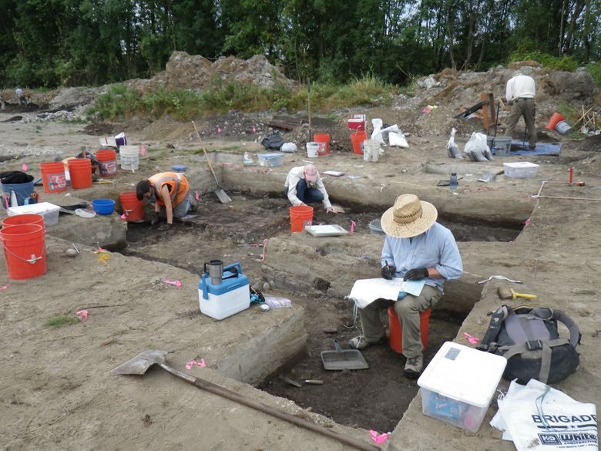
LESSON 1 · FOUNDATION
How long have people been here?
CORE
Since time immemorial. The Snoqualmie Tribe describes its people as having lived in this region longer than anyone can remember.
Bear Creek, Redmond, 2008. Archaeologists found stone tools buried beneath a layer of ancient bog. The bog itself tested at 10,000 years old, so the tools are older still.
Marymoor, Redmond. A seasonal camp used from roughly 4,000 BCE, on the National Register of Historic Places since 1970.
Inglewood Hill, Sammamish. A Snoqualmie village stood at the foot of the hill, on what is now the plateau, into the early 1900s.
The Point Elliott Treaty, 1855. Tribes signed a treaty with the United States.
Archaeologists at the Bear Creek site, Redmond, 2008
The Seattle Times
5
Notes:
[CORE] · LESSON 1 · about 3 min
KEY POINTS
Since time immemorial: the Snoqualmie Tribe describes its people as having lived here longer than anyone can remember.
Bear Creek, Redmond, 2008: stone tools beneath a bog layer that tested at 10,000 years old, so the tools are older still. Marymoor: a seasonal camp used from about 4,000 BCE. Inglewood Hill, Sammamish: a Snoqualmie village into the early 1900s.
The Point Elliott Treaty, 1855: tribes signed a treaty with the United States.
This slide anchors, but does not complete, the tribal-history requirement (RCW 28A.320.170). It supplements the district's Since Time Immemorial unit.
HOW TO TEACH IT
Two moves matter. Present tense: tribes are not a chapter that ended. And honesty about the record: historians say plainly that no link has been established between the Bear Creek toolmakers and the families living here in the 1870s. Saying so is modelling what a historian does with an incomplete record, which is the habit this whole unit teaches.
Everything on the slide comes from published sources and the Tribe's own public words. Before formal adoption, route local tribal content through your district Native education contact.
For fuller background (longhouse life, the seasonal round, salmon and cedar), use the OSPI Since Time Immemorial elementary lessons. Do not try to compress that into this slide.
ASK — AND LISTEN FOR
Q: How do we know people were here 10,000 years ago if nobody wrote it down?
Listen for: The tools, and the bog layer above them that can be dated. Evidence does not have to be words.
STANDARDS · GRADE 4
C3.4.1, H1.4.2, RCW 28A.320.170

Slide 6
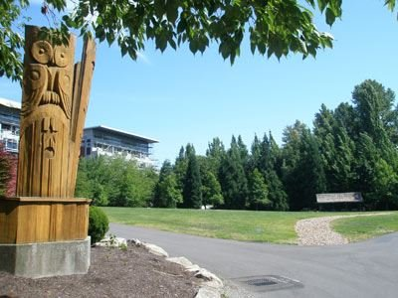
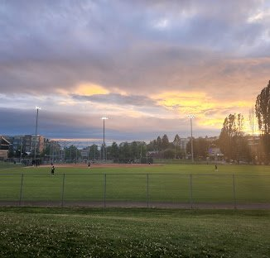
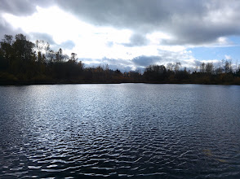
LESSON 1 · HOOK
Do you recognize any of these names?
CORE
McRedmond
Perrigo
Tosh
Wiley
Kirk
Houghton
Forbes
Monohon
Luke McRedmond Landing
Perrigo Park
Forbes Lake
6
Notes:
[CORE] · LESSON 1 · about 2 min
KEY POINTS
McRedmond, Perrigo, Tosh, Wiley, Kirk, Houghton, Forbes, Monohon: names students pass on signs every week.
These were not famous people. They were ordinary families who arrived in the 1870s and 1880s; we know their names because they owned land, ran businesses, or held office.
This is where the unit's question about whose story survived is first planted, and where the costs-and-benefits-of-moving thread begins.
HOW TO TEACH IT
Thirty seconds of hands. Most classes get McRedmond, Perrigo, Kirk and Houghton immediately. Do not take long on student questions; the point is relevance, not detail.
Name the point out loud: the reason we know these names at all is that they owned things or held office. That is exactly the problem the Whose story survived? slide takes up later. Plant it now.
ASK — AND LISTEN FOR
Q: Where have you seen these names?
Listen for: Parks, roads, a landing, a lake, a school. Then: why do we name places after people at all?
STANDARDS · GRADE 4
H2.4.1, E1.4.1

Slide 7
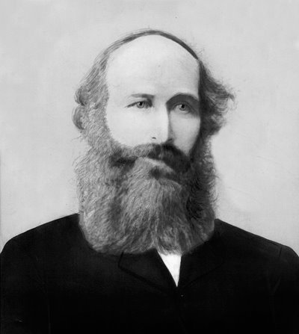
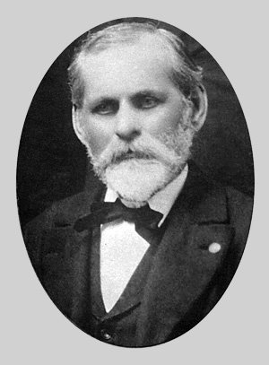
Early Families Part 1
CORE
LUKE AND KATE McREDMOND
WARREN AND LAURA PERRIGO
From Ireland.
Settled 80 acres in 1871, on land that is now Redmond Town Center.
Luke later became postmaster.
Arrived June 1871 from New Brunswick
Built an inn called Melrose House.
It was so popular the town was briefly named Melrose after it
Luke McRedmond, Warren Perrigo
HOW REDMOND GOT ITS NAME!
Salmonberg
→
Melrose
→
Redmond, 1883
the salmon were that thick in the river
after the Perrigos' inn
after the postmaster petitioned to rename it
Question: Whoever holds power names the place. Is that fair?
7
Notes:
[CORE] · LESSON 1 · about 3 min
KEY POINTS
Luke and Kate McRedmond: from Ireland; settled 80 acres in 1871 on land that is now Redmond Town Center; Luke later became postmaster.
Warren and Laura Perrigo: arrived June 1871 from New Brunswick; built the Melrose House inn, so popular the town was briefly called Melrose.
How Redmond got its name: Salmonberg (the salmon were that thick) → Melrose (after the inn) → Redmond, 1883 (after the postmaster petitioned to rename it).
Question on the slide: whoever holds power names the place. Is that fair?
HOW TO TEACH IT
The naming fight is the story to tell, and it is the individual-causes-change standard in miniature: one person caused a change that is still on every road sign in the city. Luke McRedmond, as postmaster, petitioned the post office to rename the station after himself. The Perrigos were not pleased, and the two families feuded for years.
Ask whether that is fair and let them argue. Students remember this because it is petty and human, and it is a real lesson about how the map got made: naming is a power, and it usually sits with whoever holds an office.
Both families crossed a continent or an ocean. Ask what each gave up. Neither knew what was here.
ASK — AND LISTEN FOR
Q: Whoever holds power names the place. Is that fair?
Listen for: No answer is wrong; listen for reasons. Push: who should get to name a place — the first family, the most people, a vote?
Q: What did each family give up by moving here?
Listen for: Home, relatives, a known language and climate, safety. What did they hope for? Land, a business, a fresh start.
STANDARDS · GRADE 4
H2.4.1, E1.4.1, H1.4.2

Slide 8
Early Families Part 2
CORE
The Popham and MacGregor Families
The Curtis Family
Ran a boat landing at Houghton from 1883, one of very few docks on the east side of the lake. They built boats there as well as tying them up.
IMAGE WILL GO HERE
The first families to settle the Kirkland shore, just south of today's downtown.
Martin Monohon
MARTIN MONOHON
The first permanent non-Native settler on the Sammamish plateau. He ran a ferry landing on Lake Sammamish, and in 1887 petitioned for one of the first roads up onto the plateau, providing the infrastructure for further growth of the Eastside
8
Notes:
[CORE] · LESSON 1 · about 2 min
KEY POINTS
The Popham and MacGregor families: the first to settle the Kirkland shore, just south of today's downtown.
The Curtis family: a boat landing at Houghton, one of very few docks on the east side of the lake; they built boats there as well as tying them up.
Martin Monohon: the first permanent non-Native settler on the Sammamish plateau; ran a ferry landing on Lake Sammamish and in 1887 petitioned for one of the first roads up onto the plateau.
Keep the three settlements moving in parallel: 1871 in Redmond, 1871 in Kirkland, 1877 on the plateau. These towns grew up beside each other, not one after another.
HOW TO TEACH IT
Plant Monohon hard, because the name comes back twice: the mill town on Lake Sammamish that burns in 1925, and again in 1999 when Monohon appears on the shortlist of names for the new city of Sammamish. A town can disappear and its name can still be a live option a century later.
The Curtis boat landing is the thread that runs straight into Lesson 2 and becomes a shipyard employing thousands. Say so now so the payoff lands later.
The road question is the resource standard again: access is a resource. Without a road up the hill, the plateau's soil and timber were worth almost nothing to anyone.
ASK — AND LISTEN FOR
Q: There weren't many cars back then. Why was a road so valuable?
Listen for: Wagons, animals, getting crops and timber out and supplies in; without a road the land could not be sold or farmed for money.
STANDARDS · GRADE 4
H2.4.1, E4.4.1, H1.4.2
VERIFY BEFORE PRESENTING
The image placeholder for Martin Monohon is still empty; the Sammamish Heritage Society holds a portrait.
Sources disagree on the Curtis landing: HistoryLink Essay 20514 says Frank Curtis bought land at Houghton in the 1870s; a 2005 Seattle Times feature says James Curtis operated boats from 1883. The slide keeps 1883. The Grade 7 Sourcing Lab uses this disagreement deliberately.

Slide 9
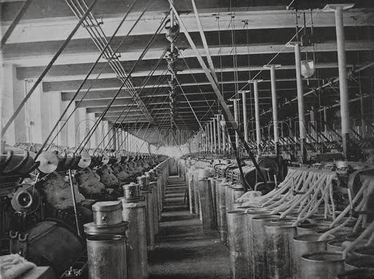
The Mills
CORE
- Mills were incredibly important to society during the late 19th / early 20th centuries because they processed raw materials at a large scale, and powered the Industrial Revolution in America
CAMPBELL MILL, REDMOND
MONOHON, SAMMAMISH
WEBER POINT, SAMMAMISH
Opened 1905 in a company town called Campton on Lake Sammamish.
Sixteen miles of track ran into the woods.
Bunkhouses were built on rail-car frames so they could be dragged to wherever the cutting was.
A full mill town on the lake's southeast shore.
Twenty homes by 1906; 300 people by 1911, with a depot, a hotel, a meeting hall, and a post office holding 125 letter boxes.
Joseph Weber started the Lake Sammamish Shingle Company here in September 1901, and a second shingle mill followed.
Shingles were incredibly important due to the rapidly increasing population
Notes:
[CORE] · LESSON 1 · about 3 min
KEY POINTS
Mills processed raw materials at scale and powered the Industrial Revolution in America; here they turned trees into lumber and shingles.
Campbell Mill, Redmond: opened 1905 in a company town called Campton on Lake Sammamish; sixteen miles of track into the woods; bunkhouses built on rail-car frames so they could be dragged to wherever the cutting was.
Monohon, Sammamish: a full mill town on the lake's southeast shore; twenty homes by 1906; 300 people by 1911 with a depot, hotel, meeting hall, and a post office with 125 letter boxes.
Weber Point, Sammamish: Joseph Weber's Lake Sammamish Shingle Company from September 1901, with a second shingle mill to follow. Shingles mattered because the population was growing so fast.
HOW TO TEACH IT
The bunkhouses-on-wheels detail is the one to slow down on. Ask who owned the bunkhouse a mill hand slept in, and wait. The answer students arrive at: these men moved with the work and did not own where they slept. That sets up the closing generalisation of the lesson.
Define company town plainly: a town owned by the company the workers work for — the store, the houses, sometimes the school. Ask what happens to your rent if you complain about your job.
The Campbell Mill pilings are still visible in Lake Sammamish near East Lake Sammamish Parkway and 187th Street NE. A student who lives near there has probably seen them without knowing what they are.
ASK — AND LISTEN FOR
Q: How much power did the mill have over the people who worked there?
Listen for: It owned the houses, the store, and the jobs; workers who complained could lose all three. Extension: working conditions, hours, injuries.
STANDARDS · GRADE 4
E4.4.2, E2.4.2

Slide 10
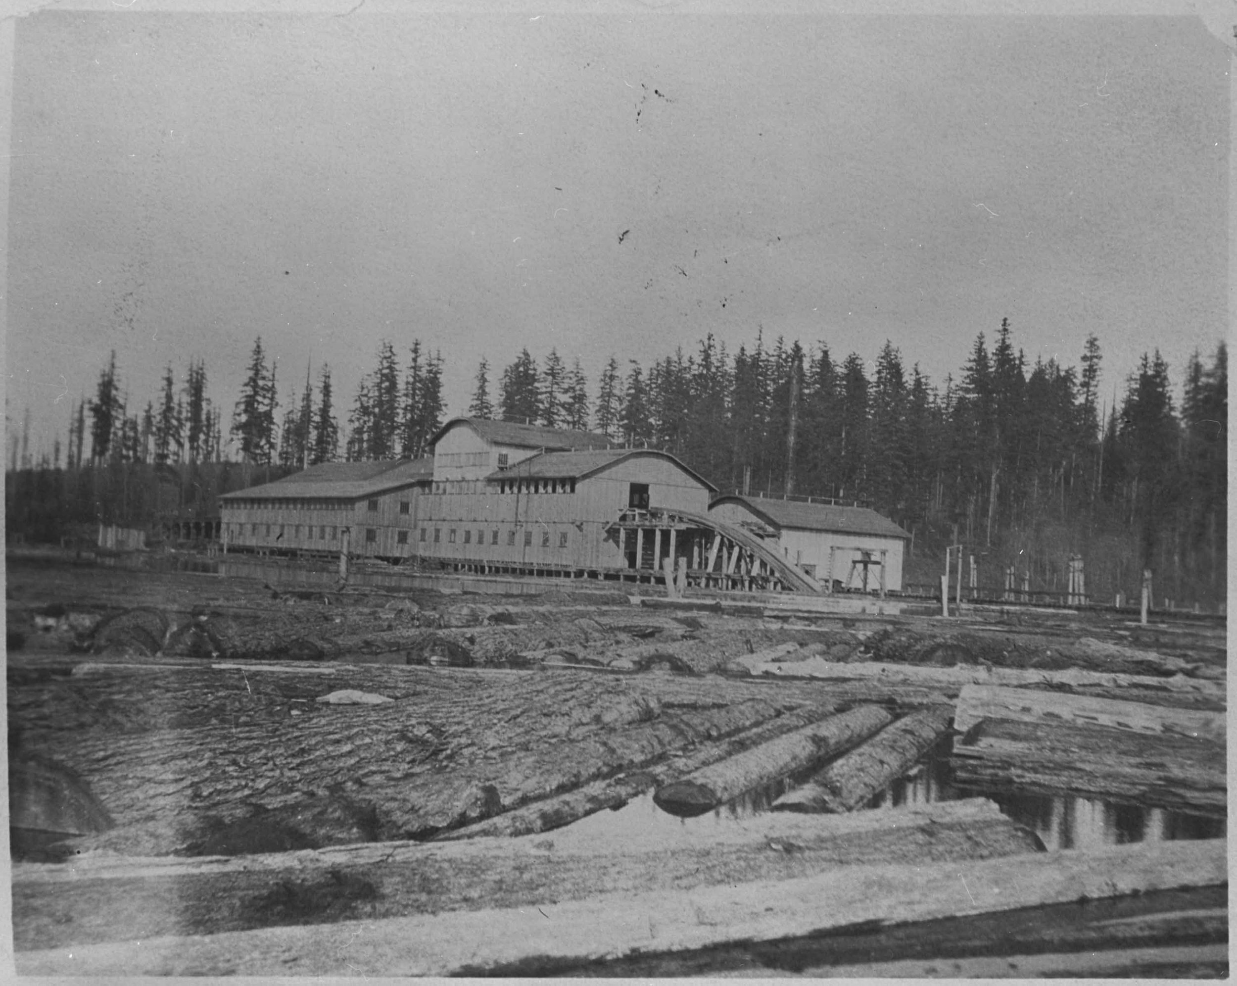
LESSON 1 · CASE STUDY
Spotlight: Monohon Mill
CORE
Monohon Mill — and the fire
120,000
board feet of lumber, every single day
20
small houses' worth of lumber, daily
300
people living in the town by 1911
Monohon Mill, Lake Sammamish, about 1906
Eastside Heritage Center
26 JUNE 1925
A fire started in the sawmill and destroyed the town. All that was left standing was a steel sawdust burner, ten company houses, and the horse barn. Although the mills were crucial to development, they were fragile, tinder waiting to burn.
DISCUSS Why were fires so common in early structures?
10
Notes:
[CORE] · LESSON 1 · about 3 min
KEY POINTS
120,000 board feet of lumber every day, roughly twenty small houses' worth, in a town of about 300 people (1911).
26 June 1925: a fire started in the sawmill and destroyed the town. Left standing: a steel sawdust burner, ten company houses, and the horse barn.
The mills were crucial to development and fragile — tinder waiting to burn. Discussion: why were fires so common in early structures?
HOW TO TEACH IT
Read the numbers aloud so they are not available only by sight, and contrast them: twenty houses' worth of lumber a day, in a town of 300.
The question on the slide (why were fires so common?) has concrete answers; take three and move on. Then ask the follow-up, which has no tidy answer and should not get one: what happens to a town when its mill burns? Somebody will say people move away, which is right. Somebody may say they rebuild, which is also right: the mill was rebuilt, the town was not.
Fire is the quiet through-line of Lesson 1. Monohon burns in 1925; Redmond's hotel fires are part of why it wanted to incorporate and sell bonds for a water system. Flag that now, because the incorporation slide is three slides away.
ASK — AND LISTEN FOR
Q: Why were fires so common in early structures?
Listen for: Everything was wood, including the thing that made wood; sawdust everywhere; stoves, lamps and boilers; no water system; no fire department. Extension: why keep building in wood anyway? It was the cheapest material on earth here.
Q: What happens to a town when its mill burns?
Listen for: People leave, or rebuild; the mill was rebuilt, the town was not.
STANDARDS · GRADE 4
E4.4.2

Slide 11
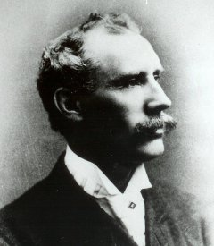
The Abandoned Steel Mill
CORE
1886
Peter Kirk came from England in 1886 to build a steel town. The mill never produced a single piece of steel.
He planned a whole city with British street names. Steelworkers moved their families from Workington, England, for jobs there.
Because Kirk was not a United States citizen, the Homestead Act would not let him buy land. His business partner bought it for him.
In 1893 the country hit serious money trouble. Investors pulled out, and the mill was abandoned half-built.
Kirk arrives from England
1888–92
Town platted, houses built, families arrive from Workington
1892
Mill completed
1893
National financial panic; investors withdraw
After
Abandoned half-built. No steel ever made.
11
Notes:
[CORE] · LESSON 1 · about 3 min
KEY POINTS
Peter Kirk came from England in 1886 to build a steel town. He planned a whole city with British street names; steelworkers moved their families from Workington, England.
Because Kirk was not a United States citizen, the Homestead Act would not let him buy land. His business partner bought it for him.
1892: mill completed. 1893: national financial panic; investors pulled out; the mill was abandoned half-built. It never produced a single piece of steel.
HOW TO TEACH IT
Two things to name. The human cost: families crossed an ocean for jobs that never existed. Ask what those families did next — that is the part the plaques leave out, and the next slide is partly the answer.
Keep the citizenship detail in your pocket. A law stopped a wealthy Englishman from owning land, and he simply had a partner buy it for him. The same kind of law appears six slides from now, applied to Japanese immigrant families who had far less room to manoeuvre. Do not preview it. Students who spot the echo on their own are doing real historical thinking.
This is a community whose whole economic plan failed because of something that happened somewhere else entirely — a panic in New York.
ASK — AND LISTEN FOR
Q: What did the Workington families do next?
Listen for: Stayed and found other work (the next slide), or left. There was no steel job to go back to.
STANDARDS · GRADE 4
E4.4.2, H3.4.1, H1.4.2

Slide 12
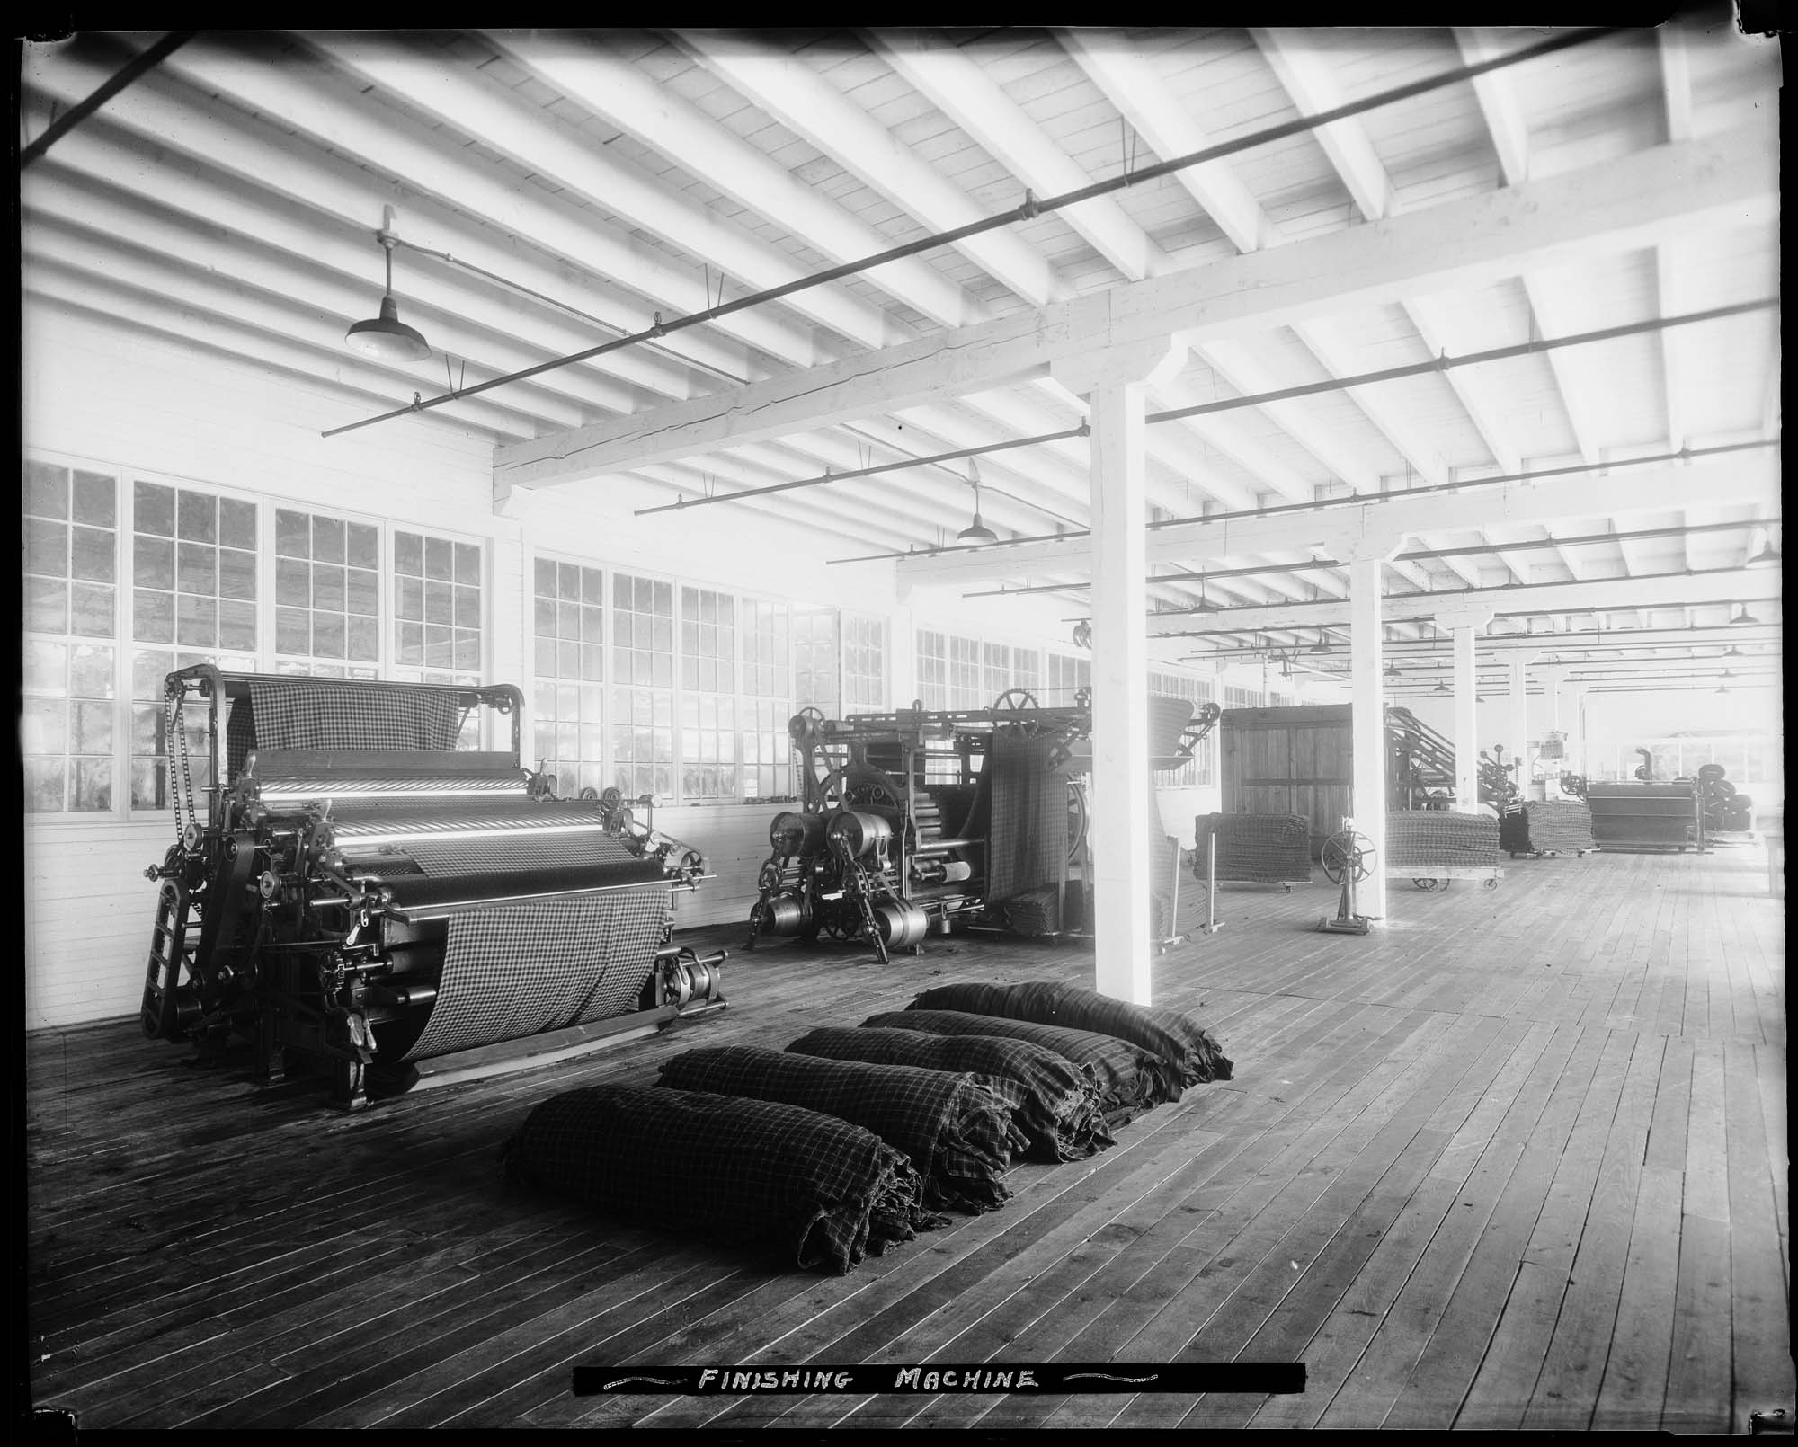
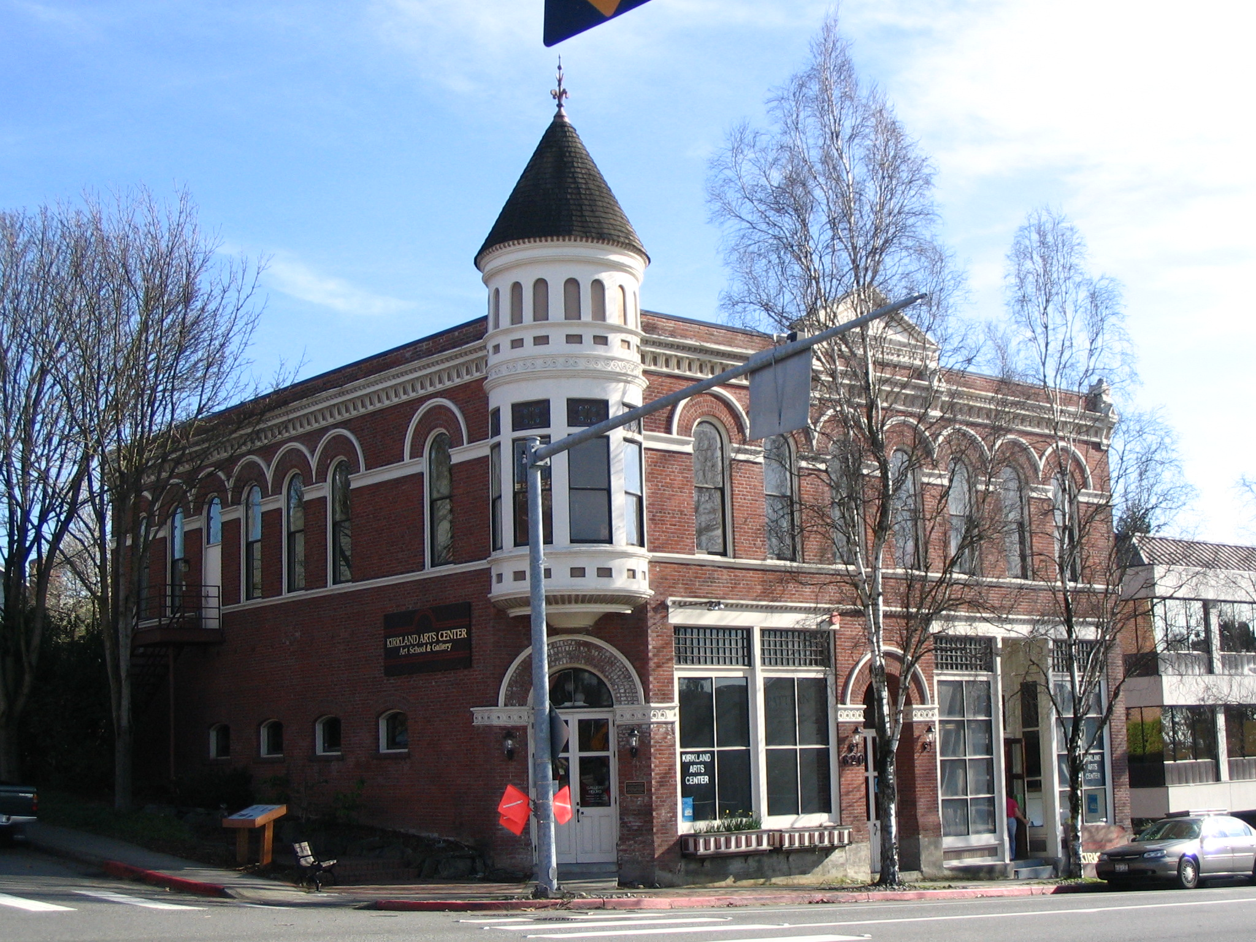
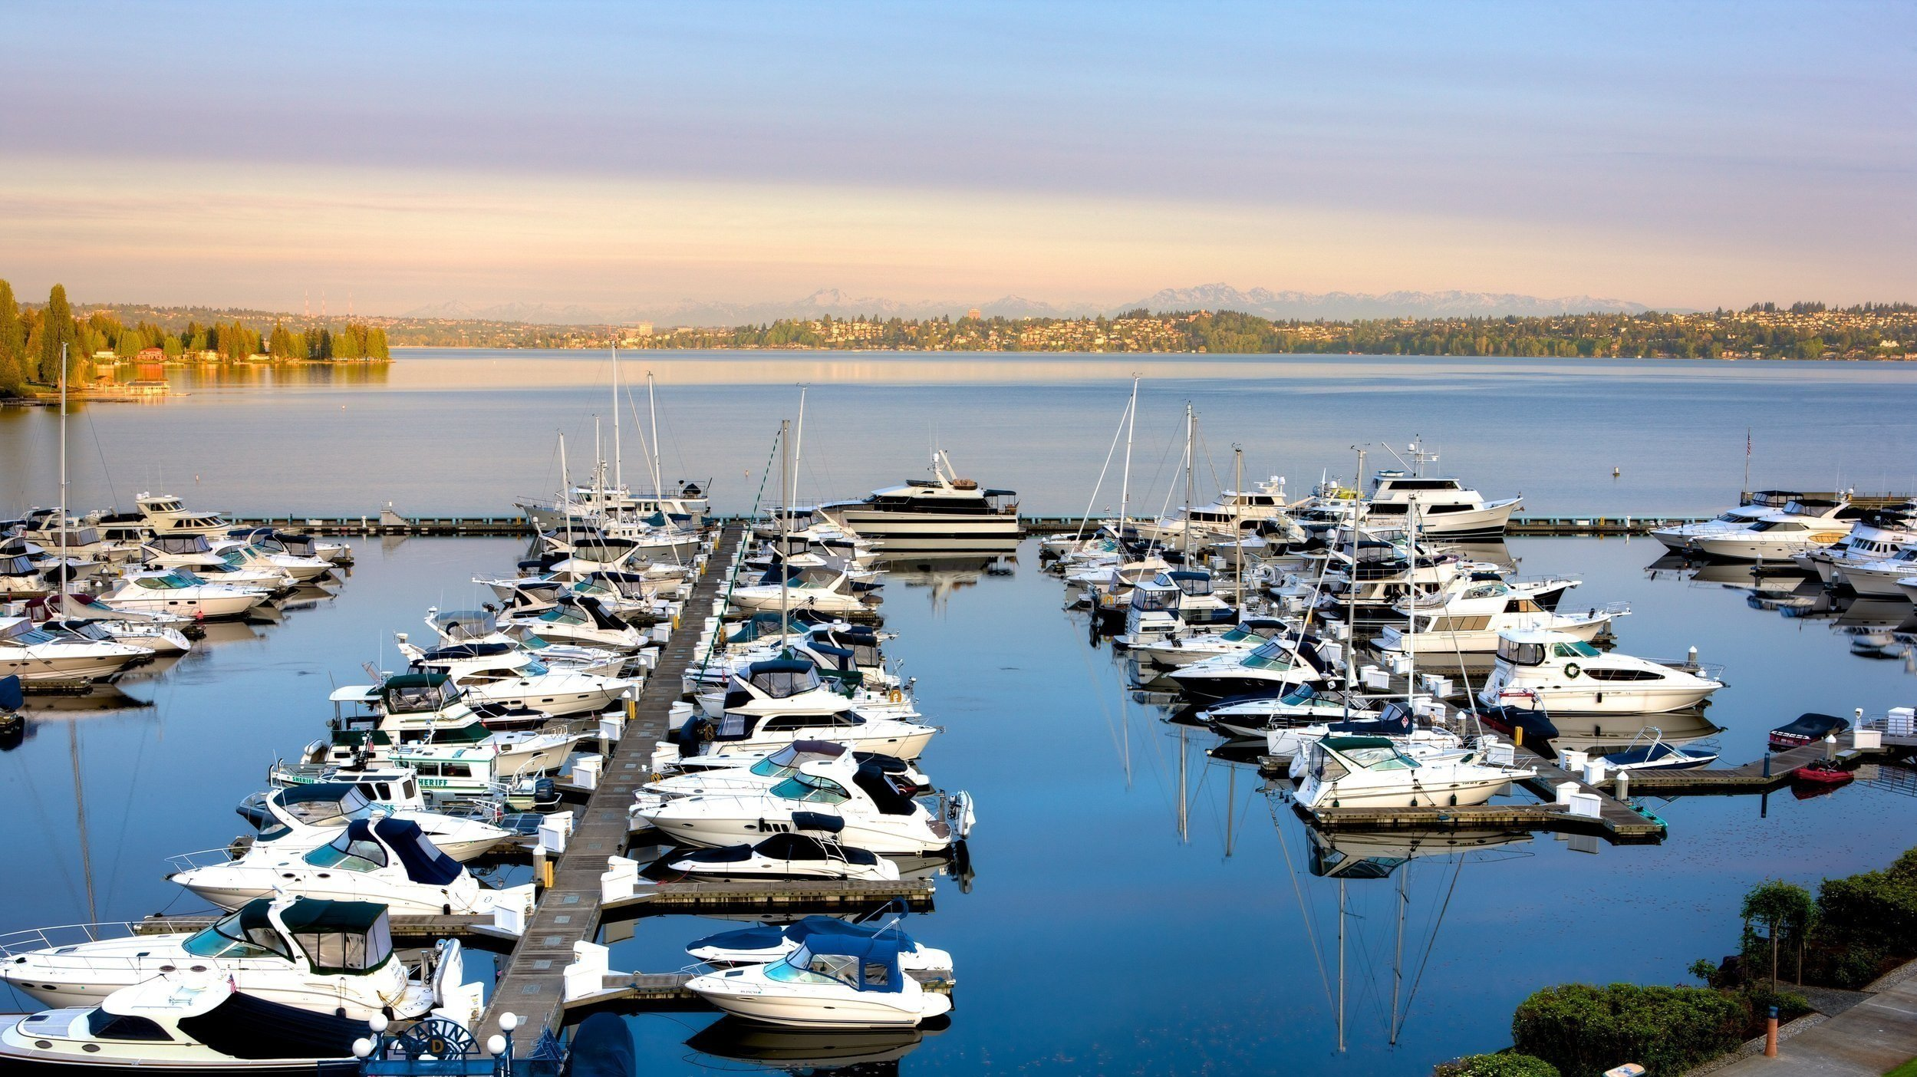
Kirkland’s Other Ventures
CORE
WOOL
BRICKS
BOATS
A woolen mill opened at Moss Bay in 1892, the first in Washington. It sold blankets and clothing to prospectors heading for the Alaska Gold Rush, and later to the military in the First World War.
A brickworks was built to supply the steel mill and the new town. The most famous one that stands today is the Peter Kirk Building.
The Curtis family ran a boat landing from 1883, one of the few Eastside docks, and built boats there. That yard grew into the Lake Washington Shipyard, seen at Carillon Point today
DISCUSS Which of these three do you think was the best investment in 1893?
12
Notes:
[CORE] · LESSON 1 · about 2 min
KEY POINTS
Wool: a woolen mill at Moss Bay in 1892, the first in Washington; blankets and clothing for Alaska Gold Rush prospectors and later the military in the First World War.
Bricks: a brickworks built to supply the steel mill and the new town; the Peter Kirk Building still stands.
Boats: the Curtis family's landing from 1883 grew into the Lake Washington Shipyard, on the site of today's Carillon Point.
Sentence frame: because the steel mill failed, people made wool and bricks and boats instead.
HOW TO TEACH IT
This is the cause-and-effect slide for Kirkland. Have students say the sentence frame in that form.
The boatyard thread runs straight into Lesson 2, where it becomes a wartime shipyard employing thousands on three shifts. The bricks thread runs into the Early Businesses photos: the Peter Kirk Building is made of bricks fired for a mill that failed.
Show of hands on the discussion question, then ask how we could tell which venture was the best investment (which one is still there? which employed the most people?).
ASK — AND LISTEN FOR
Q: Which of these three do you think was the best investment in 1893?
Listen for: Any, with reasons. Boats lasted longest (a shipyard for fifty years); wool made money fastest (the Gold Rush); bricks left the most visible mark.
Q: Why weren't these Peter Kirk's first choices?
Listen for: He wanted one big industry; these were smaller, local, less glamorous — and they worked.
STANDARDS · GRADE 4
E4.4.2, E2.4.2

Slide 13
LESSON 1 · BECOMING CITIES
Two towns vote yes
CORE
KIRKLAND
REDMOND
1905
1912
Voted to incorporate on 12 October, with about 400 people. The steel mill had failed twelve years earlier. The town outlived the reason it was built.
State law required 300 residents to incorporate. Redmond had 299 and had to wait. After several bad fires, the town wanted to incorporate so it could sell bonds and build a real water system.
WHAT INCORPORATING MEANS
Officially becoming a town or city under state law, allowing a place collect taxes, borrow money, and run its own fire department. Bellevue will not do it until 1953, and Sammamish not until 1999.
ASK What are some of the drawbacks that come with incorporation?
13
Notes:
[CORE] · LESSON 1 · about 3 min
KEY POINTS
Kirkland, 1905: voted to incorporate on 12 October with about 400 people, twelve years after the steel mill failed. The town outlived the reason it was built.
Redmond, 1912: state law required 300 residents; Redmond had 299 and had to wait. After several bad fires the town wanted to incorporate so it could sell bonds and build a real water system.
Incorporating means officially becoming a town or city under state law: collecting taxes, borrowing money, running a fire department. Bellevue will not do it until 1953, Sammamish not until 1999.
HOW TO TEACH IT
This is where the responsibilities and powers of local government live. Redmond wanted to incorporate partly so it could sell bonds and build a proper water system; after several bad fires a volunteer bucket brigade was not enough. Make the connection to Monohon out loud: fire shaped the government of this valley.
The 299-residents detail usually gets a laugh, and it is a real illustration of how law works: a number in a statute decided when a town could exist.
Bellevue in 1953 and Sammamish in 1999 both land in Lesson 2, which lets students see incorporation as a question communities keep answering rather than a one-time event.
ASK — AND LISTEN FOR
Q: What are some of the drawbacks that come with incorporation?
Listen for: Taxes, rules, having to run things yourself (police, fire, water), arguments about who is in charge. Benefits: borrowing for a water system, a fire department, deciding your own future.
STANDARDS · GRADE 4
C2.4.1, H2.4.1

Slide 14
LESSON 1 · GEOGRAPHY
The lake drops nine feet
ADDITIONAL
In August 1916 engineers opened a canal from Lake Washington to Puget Sound. Over the next three months the lake fell about nine feet, and the Eastside's shoreline moved.
1912
Renton turns the Cedar River into the lake
KIRKLAND
JUANITA BAY
SAMMAMISH RIVER
25 AUG 1916
The old steamboat docks were left high and dry. A brand-new waterfront appeared at the foot of Kirkland Avenue, and the ferry landing moved there.
The falling water uncovered a wide beach of fine white sand. Five hundred feet from shore the water was only five feet deep, so Juanita's ferry had to stop running.
The river ran faster and shallower. Steamboats could no longer reach Bothell. Decades later it was dredged and straightened, and today it is about four miles shorter.
The Montlake Cut opens and the lake begins to drop
OCT 1916
Nine feet lower. The Black River dries up
4 JULY 1917
The Ballard Locks officially open
WHAT DISAPPEARED
1965
The Black River, the lake's old outlet, dried up completely. More than a thousand acres of lakeside wetland became dry ground, and a Bellevue lumber company that floated its logs down the Mercer Slough lost the water it depended on.
Sammamish River dredged and straightened
ASK Who gained from a lower lake? Who lost? Was anyone asked?
14
Notes:
[ADDITIONAL] · LESSON 1 · +3 min if used
KEY POINTS
25 August 1916: the Montlake Cut opened, joining Lake Washington to Lake Union and, through the new canal and locks, to Puget Sound. Over about three months the lake fell about nine feet. The Ballard Locks formally opened on 4 July 1917.
The Black River, the lake's old outlet, dried up completely; the canal became the new outlet. More than a thousand acres of lakeside wetland became dry ground.
Kirkland: steamboat docks left high and dry; a new waterfront at the foot of Kirkland Avenue. Juanita Bay: a wide sandy beach appeared and the ferry had to stop. Sammamish River: faster and shallower; steamboats could no longer reach Bothell; dredged and straightened in the 1960s (finished 1965) and now about four miles shorter.
A Bellevue lumber company that floated logs down the Mercer Slough lost the water it depended on.
HOW TO TEACH IT
This is a geography slide: one engineering decision in Seattle rewrote the Eastside's shoreline. Read the lead line, then take the three cards as three places students may know. If anyone has been to Juanita Beach, they have stood on land that was underwater in 1915.
Use the timeline on the right to keep the sequence straight, and hold the closing question until the end. The honest answer to “was anyone asked?” is that Seattle's shipping interests wanted the canal; Eastside farmers, mill owners, ferry operators and the Duwamish people at the Black River were not consulted in any way students would recognise.
Connect forward: the Sammamish River that runs past Redmond today is the straightened 1960s channel, not the winding slough the McRedmonds and Perrigos knew.
ASK — AND LISTEN FOR
Q: Who gained from a lower lake? Who lost? Was anyone asked?
Listen for: Gained: Seattle shippers, farmers who got new dry land, beach-goers at Juanita. Lost: steamboat and ferry operators, the Bothell river trade, the Hewitt-Lea lumber company, wetland wildlife, the people who lived along the Black River. Asked: essentially no one on the Eastside.
STANDARDS · GRADE 4
E4.4.1, H2.4.3, G2.4.1 (supporting)
VERIFY BEFORE PRESENTING
Sources give the drop as 9 feet (HistoryLink Essays 686 and 1444) or 8.8 feet (HistoryLink Essay 4009). The slide says “about nine feet.”
The Corps of Engineers straightening project began in 1962–63 and finished in 1965; sources differ on the start year.

Slide 15
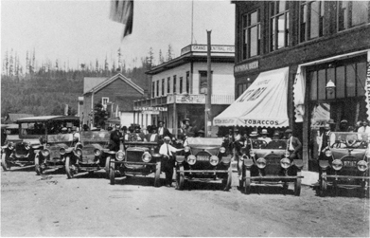
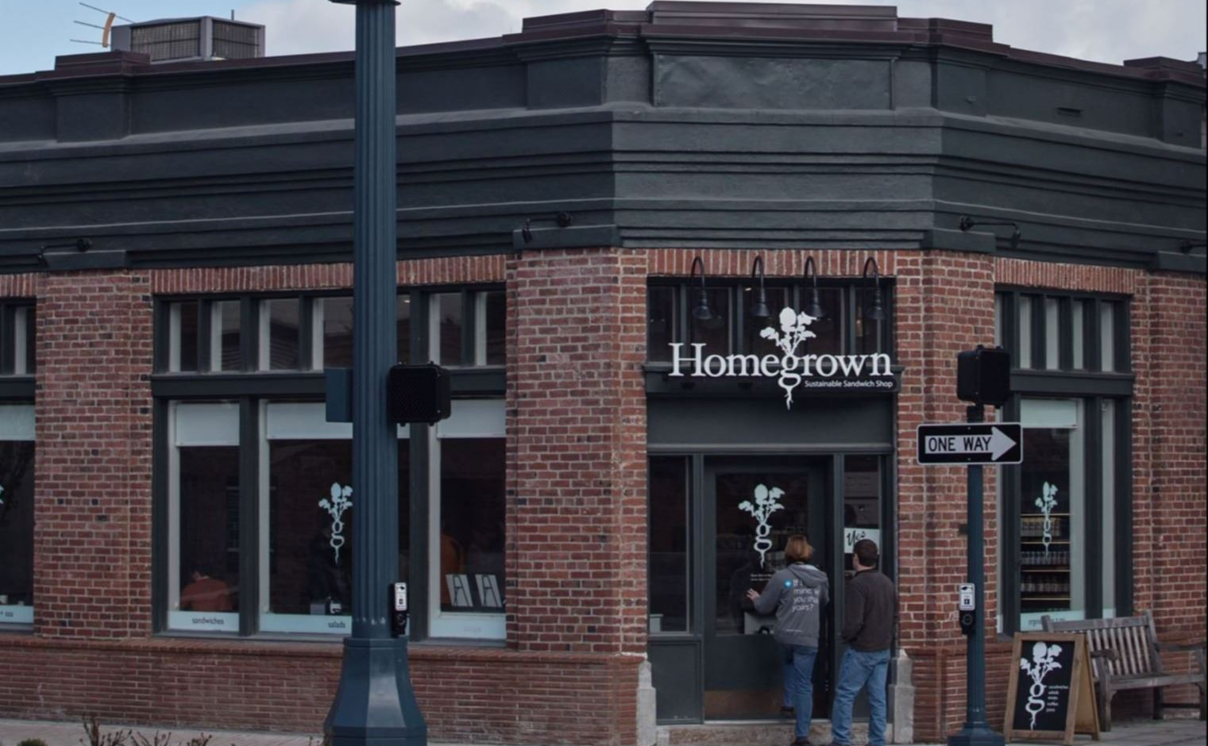
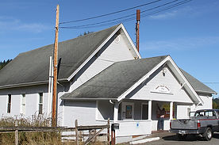
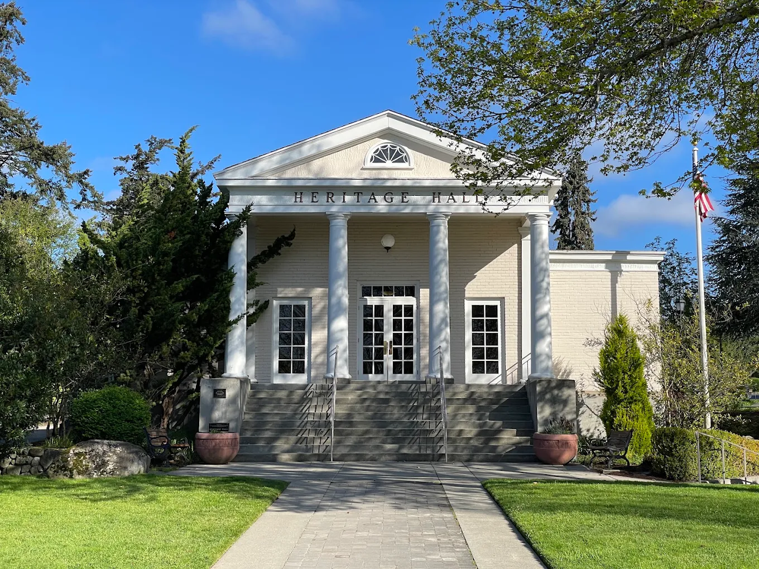
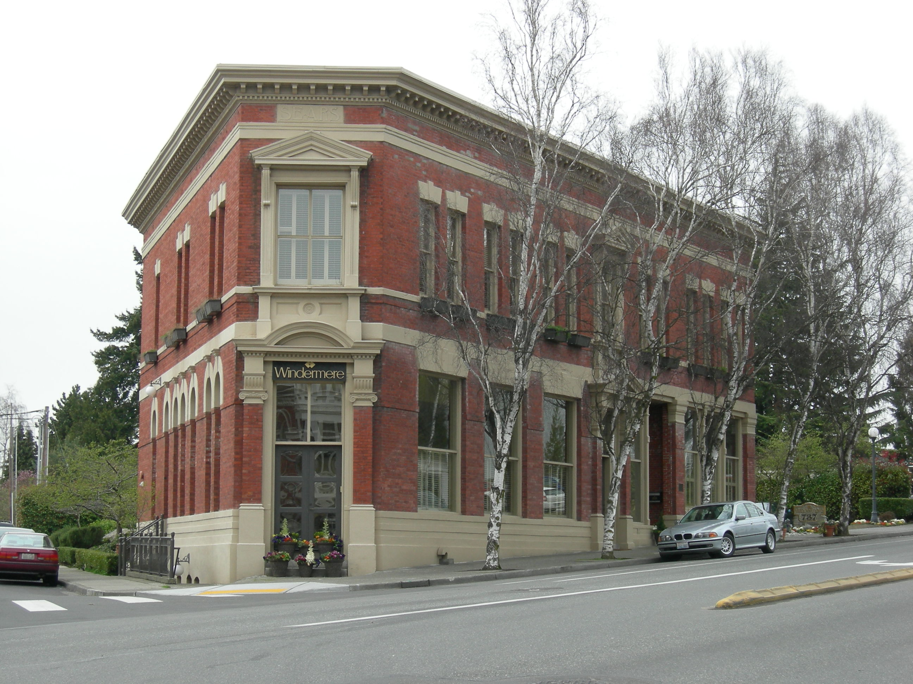
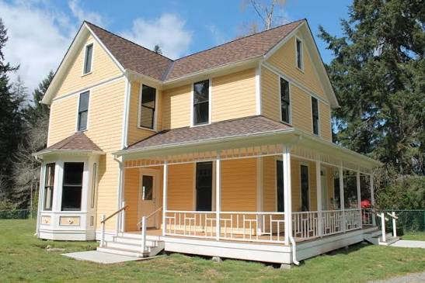
ADDITIONAL
Early Businesses
Bill Brown’s Garage, Redmond
Redmond State Bank Today
Happy Valley Grange, Redmond
Heritage Hall, Kirkland
The Joshua Sears Building, Kirkland
The Reard House, Sammamish
15
Notes:
[ADDITIONAL] · LESSON 1 · +2 min if used
KEY POINTS
Six places: Bill Brown's Garage and the Happy Valley Grange (Redmond), the Redmond State Bank building, Heritage Hall and the Joshua Sears Building (Kirkland), the Reard House (Sammamish).
None of these are glamorous industries, and they are exactly what turns a settlement into a town: a bank, a store, and somewhere to argue.
Bill Brown is the through-line of the whole unit: saloon owner, garage owner, logging-company president, and mayor of Redmond for roughly thirty years from 1919. He comes back in Lesson 2 as the man who starts the 1939 bicycle race.
A Grange is a farmers' organisation: co-operative buying, plus a hall for meetings and dances.
HOW TO TEACH IT
Droppable if you are short on time; the economic-elements standard is already carried by the mills and the farms slides. If you keep it, do not spend long: a sentence on each photograph and the role it played.
If you have a spare minute, ask whether one person should be able to own the saloon, own the garage, and run the town at the same time. There is no right answer and it is a good thirty seconds.
ASK — AND LISTEN FOR
Q: Which of these would you miss most if your town did not have one?
Listen for: Bank (money), store or garage (things), hall (people). All three are needed.
STANDARDS · GRADE 4
E2.4.2, SSS3.4.1
VERIFY BEFORE PRESENTING
Photo captions to verify before presenting: confirm the date and street on the historic image, and confirm the current tenant of the bank building.

Slide 16
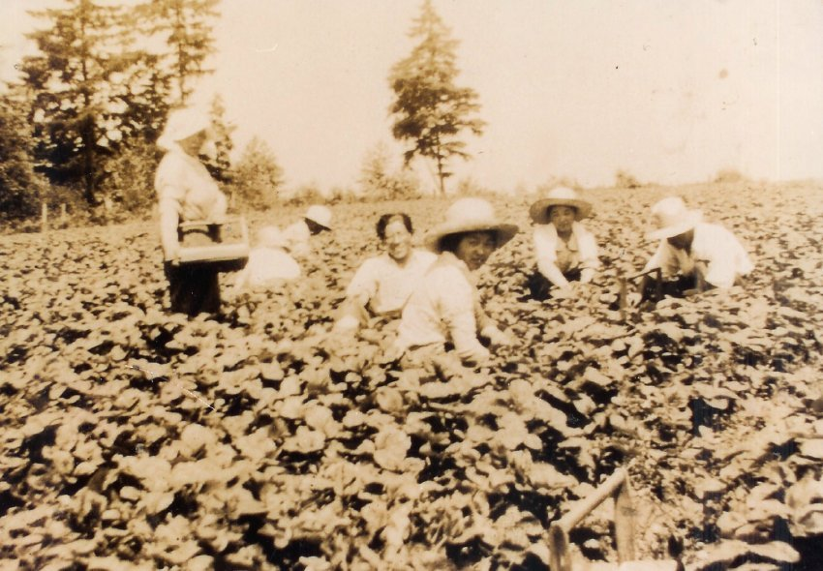
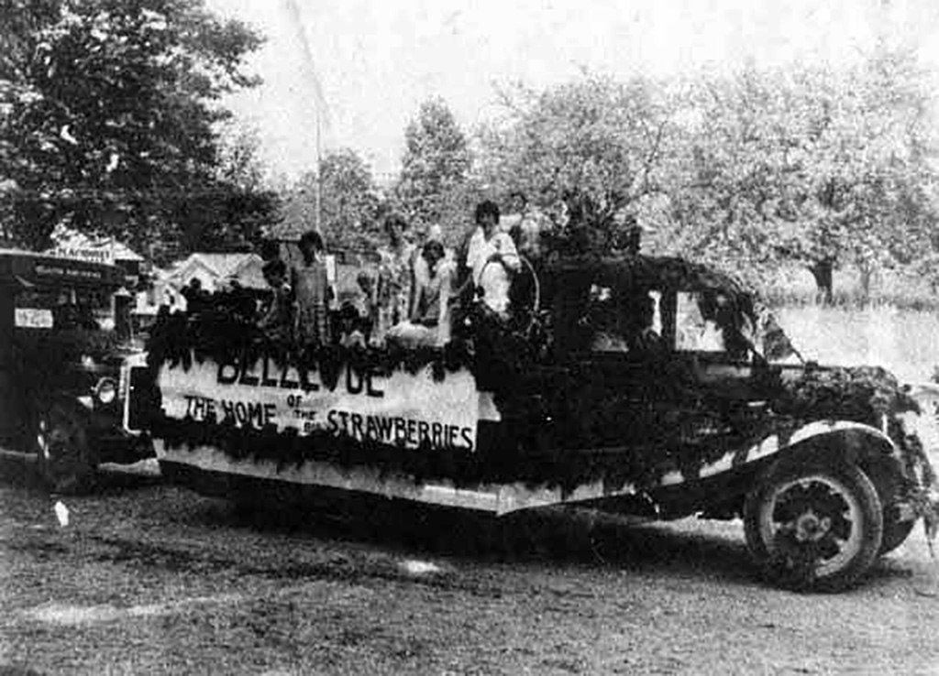
From stumps to farms
CORE
When the loggers left, they left behind enormous stumps. Clearing that land was brutal work, and the owners who held it had very little use for it.
Japanese immigrant families took on the stumplands, pulled the stumps by hand and by horse, and turned them into some of the best farmland on the Eastside.
They organised. A growers' association formed in 1930 and built its own packing shed in 1933. By 1931 Eastside growers were shipping strawberries and peas across the Northwest by rail.
By the late 1930s, around nine of every ten Eastside farm workers were Japanese American. Bellevue's Strawberry Festival was the region's celebration of their crop.
9 in 10
Eastside farm workers were Japanese American by the late 1930s
In 1930
growers' association founded
In 1933
They had their own packing shed built
16
Notes:
[CORE] · LESSON 1 · about 3 min
KEY POINTS
When the loggers left, they left enormous stumps. Clearing that land was brutal work, and the owners who held it had little use for it.
Japanese immigrant families took on the stumplands, pulled the stumps by hand and by horse, and turned them into some of the best farmland on the Eastside.
They organised: a growers' association in 1930, their own packing shed in 1933; by 1931 Eastside growers were shipping strawberries and peas across the Northwest by rail.
By the late 1930s about nine of every ten Eastside farm workers were Japanese American. Bellevue's Strawberry Festival (first held June 1925) was the region's celebration of their crop.
HOW TO TEACH IT
Go back to the chart paper from the setting slide and check the class's guesses. This is the payoff for holding that question for twelve slides; do not skip the callback.
Introduce these families as farmers, organisers and business people — people with skills, capital and a co-operative. Lesson 2 covers what was done to them in 1942, and it lands very differently if students have met them first as neighbours and successful growers rather than as victims. Do not preview 1942 here. Not even a hint.
More texture if you want it: chicken farms by the hundred, dairies, mink ranches on Union Hill, truck farms in the valley bottom growing vegetables for Seattle markets. Trade and interdependence is in the rail-shipping detail: Eastside strawberries on a table in Spokane.
Bellevue is named explicitly here because this is where the unit's Bellevue thread begins; it runs through three slides in Lesson 2.
ASK — AND LISTEN FOR
Q: Look at our guesses from the start of the lesson. Which ones came true?
Listen for: Farming did, but not the way anyone guessed: it took a second group of people, and it took decades of stump-pulling first.
Q: Why ship strawberries by train instead of selling them here?
Listen for: More buyers, better prices; the railroad made a farm in Bellevue part of a bigger market.
STANDARDS · GRADE 4
E4.4.3, H2.4.2, RCW 28A.345.130
VERIFY BEFORE PRESENTING
The 90 percent figure: Eastside Heritage Center states that before the Second World War about 300 Japanese Americans lived in Bellevue, 15 percent of the population and 90 percent of the agricultural workforce. The slide generalises to “Eastside”; Bellevue is the documented case.

Slide 17
A rule that did not apply to everyone
CORE
PETER KIRK, 1886
JAPANESE IMMIGRANT FAMILIES
A British citizen, so the law would not let him buy land in Washington.
Many could not become United States citizens, and so could not own land in their own names either.
WHAT HE DID ABOUT IT
WHAT THEY DID ABOUT IT
His wealthy business partner bought it for him. The obstacle cost him a signature.
Some held land in the names of their American-born children, who were citizens by birth. Others could only lease land or work someone else's.
The same kind of rule hit two groups very differently, depending on certain things
ASK What happened between these groups that was the same? That was different? Why?
17
Notes:
[CORE] · LESSON 1 · about 3 min
KEY POINTS
Peter Kirk, 1886: a British citizen, so the law would not let him buy land in Washington. What he did: his wealthy business partner bought it for him. The obstacle cost him a signature.
Japanese immigrant families: many could not become United States citizens, and so could not own land in their own names either. What they did: some held land in the names of their American-born children, who were citizens by birth; others could only lease land or work someone else's.
The same kind of rule hit two groups very differently, depending on what else they had.
HOW TO TEACH IT
Keep this concrete and short: four or five minutes at most. The idea students need to hold is the sentence on the slide.
If a student made the Peter Kirk connection on their own back at the steel-mill slide, name them for it now. If nobody did, the side-by-side layout does the work.
This is the clearest place in Lesson 1 where the unit meets the inclusive-materials requirement: the history and perspective of an underrepresented group sits at the centre of the economic story rather than being added on beside it. Do not extend into 1942. That is Lesson 2 and it needs its own room.
ASK — AND LISTEN FOR
Q: What happened between these groups that was the same? That was different? Why?
Listen for: Same: a law about citizenship blocked land ownership. Different: money, connections, and a partner who could sign made the rule a formality for Kirk; for the farm families it shaped everything. Why: wealth, race, and who the law was written to keep out.
STANDARDS · GRADE 4
H3.4.1, RCW 28A.345.130

Slide 18
LESSON 1 · PRIMARY SOURCE
How to read a photograph
CORE
1
Who made this?
2
When was it made?
3
Why was it made?
4
How do we know we can trust it?
Logging railroad, Eastside, about 1885
Eastside Heritage Center
18
Notes:
[CORE] · LESSON 1 · about 4 min
KEY POINTS
Four questions, used again in Lesson 2 and in the closing activity: Who made this? When was it made? Why was it made? How do we know we can trust it?
The photograph: a logging railroad on the Eastside, about 1885, Eastside Heritage Center.
Teach the routine, not just this photograph. Run it as a whole-class think-aloud the first time; one to two minutes per question.
HOW TO TEACH IT
Expected answers worth having ready. Who made it: almost certainly the logging company or a commercial photographer working for it, because cameras were expensive and camps were remote. Why: to show investors the operation was real and running. That reframes the photograph from neutral record to something closer to an advertisement, which is exactly the shift you want.
The closing question is the bridge to the next slide. Expect: the men who slept in the bunkhouses are barely visible, and nobody who cooked, washed, or kept the books is in frame at all.
Accessibility: describe the photograph aloud in detail — cut-over hillside, felled trunks, narrow track running to the horizon, a handful of men standing on a timber trestle — so every student can participate without seeing it. Printing the image for table groups works well.
ASK — AND LISTEN FOR
Q: Who made this? When? Why? How do we know we can trust it?
Listen for: Company or hired photographer; about 1885 (the archive's date; how would they know?); to show investors or advertise; we trust it partly — it shows real track and trees, but it shows what the company wanted shown.
Q: Who is missing from the picture?
Listen for: Cooks, bookkeepers, families, anyone not posed for the camera.
STANDARDS · GRADE 4
SSS1.4.2

Slide 19
Whose story survived?
CORE
Almost everything we know the eastside was written down by the people who owned the newspapers, the land, or the businesses.
WE HAVE
WE BARELY HAVE
WE ALMOST LOST
Peter Kirk's company papers, Bill Brown’s memos, and Emma McRedmond's hotel records.
anything written by the men and women who worked in the mills and the department stores.
The farms the Japanese immigrant families built. In 1942 most of those families were forced to leave, and much of what they owned never came back.
If the people who write things down are the people with power, what is missing from our history?
19
Notes:
[CORE] · LESSON 1 · about 3 min
KEY POINTS
Almost everything we know about the Eastside was written down by the people who owned the newspapers, the land, or the businesses.
We have: Peter Kirk's company papers, Bill Brown's memos, Emma McRedmond's hotel records. We barely have: anything written by the men and women who worked in the mills and stores. We almost lost: the farms the Japanese immigrant families built; in 1942 most of those families were forced to leave, and much of what they owned never came back.
Question: if the people who write things down are the people with power, what is missing from our history?
HOW TO TEACH IT
This slide does the work the inclusive-materials requirement asks for, and it does it as history rather than as a disclaimer. The honest way to include underrepresented groups in local history is to teach students that the archive itself is uneven, and to name who is missing from it.
Expect good answers: people who could not write English, people who were renting rather than owning, children, people who moved on after a season, people whose houses were torn down.
The “we almost lost” column is the only forward reference to 1942 in Lesson 1, and it is deliberately one sentence. Do not expand it here.
ASK — AND LISTEN FOR
Q: If the people who write things down are the people with power, what is missing from our history?
Listen for: Workers, renters, children, people who did not write English, people who left; anyone whose papers were not kept.
Q: Extension: most of these sources are paper. What changes in the digital era?
Listen for: Everyone writes, but almost nothing is kept on purpose; who decides what survives now?
STANDARDS · GRADE 4
H3.4.4, SSS1.4.2, RCW 28A.345.130

Slide 20
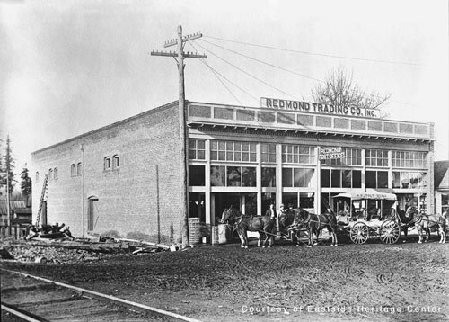
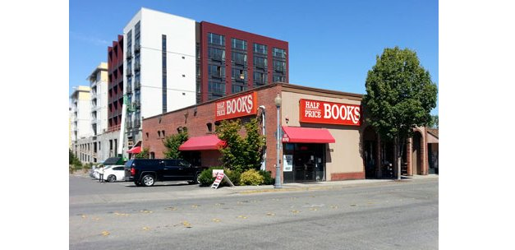
Photo Match!
CORE
I will pass out ten old images and ten modern locations, and your job is to connect the old and the new!
Example: The Redmond Trading Co. building is now Half Price Books!
20
Notes:
[CORE] · LESSON 1 · about 6 min
KEY POINTS
Closing activity: ten old images and ten modern locations; groups of three to five connect the old and the new. Three to four minutes of sorting; most correct wins.
Example on the slide: the Redmond Trading Co. building is now Half Price Books.
Debrief lands the lesson's generalisation: in this valley, the people who did the work and the people whose names ended up on the buildings were often not the same people.
HOW TO TEACH IT
Materials: ten historic images and ten present-day photographs of the same sites, printed one set per group. Good pairs from this unit: the Redmond Trading Co. → Half Price Books; the Curtis boat landing → Carillon Point; the Peter Kirk Building then and now; Bill Brown's Saloon and garage → downtown Redmond; the Kirkland ferry dock → Marina Park; the Redmond depot → the Redmond Central Connector trail; the McRedmond farm → Redmond Town Center; the Monohon mill site → East Lake Sammamish Parkway; Campbell Mill → the pilings near 187th Street NE; Heritage Hall and the Reard House then and now. The Redmond Historical Society, Kirkland Heritage Society and Eastside Heritage Center hold the historic images; take the modern photographs yourself.
Say the labels aloud, and if you use coloured cards label the two sets in words as well, so colour is never the only signal.
Debrief in two minutes: for each pair, who built the old one, and whose name (if any) is on the new one? Land the generalisation before the bell. If you have three minutes more, ask which category students' own families would fall in — but let it be optional, and never call on a student for a family story.
ASK — AND LISTEN FOR
Q: How did you decide which old picture matched which new one?
Listen for: Shape of the building, the shoreline, a road, a sign; the same skills as the four photograph questions.
Q: Whose names ended up on the buildings, and who did the work?
Listen for: Owners' names survive; workers' names mostly do not.
STANDARDS · GRADE 4
SSS1.4.2, SSS3.4.1
MATERIALS
Ten historic images and ten modern photographs of the same sites, one printed set per group; tape or a sorting sheet.

Slide 21
CORE
LESSON 2
Strawberries, Shipyards, and Software
OPENING QUESTION
“How did a farm town of 500 people become a region of half a million?”
Notes:
[CORE] · LESSON 2 · about 1 min
KEY POINTS
Opening question: “How did a farm town of 500 people become a region of half a million?”
The lesson answers it in three parts — people, laws, and technology — but do not give students that framing yet. Let them build the list themselves; at the Social Justice slide and the closing activity, sort the class's answers into those three columns on the board.
Lesson 2 runs in slate rather than brown so a teacher flipping through can tell instantly which lesson a slide belongs to. Colour is never the only signal; every slide is also labelled in the kicker line.
HOW TO TEACH IT
Keep the opening question projected for the whole lesson if you can; the synthesis on the Social Justice slide and the closing activity both come back to it.
ASK — AND LISTEN FOR
Q: How did a farm town of 500 people become a region of half a million?
Listen for: Microsoft, jobs, bridges, people moving; write them all down; do not confirm.
STANDARDS · GRADE 4
Framing slide; no standard is assessed here.

Slide 22
Where we left off
CORE
1880s
1920s
1930s
TODAY
FOREST
STUMPS
FARMS
?
→
→
→
Mills at Campton, Monohon and Weber Point
The big trees are gone. Monohon burns in 1925.
Strawberries, peas, chickens, dairy, mink
What happened here?
80,280
573
Case Study: Redmond
people living in Redmond in 1950
people living in Redmond today
DISCUSS Turn and tell your partner: what do you think happened in between?
22
Notes:
[CORE] · LESSON 2 · about 3 min
KEY POINTS
Lesson 1 in four beats: forest (1880s: mills at Campton, Monohon and Weber Point) → stumps (1920s: the big trees are gone; Monohon burns in 1925) → farms (1930s: strawberries, peas, chickens, dairy, mink) → today (?).
Two numbers stake the mystery: 573 people living in Redmond in 1950; about 80,280 today.
Sixty seconds of partner talk, then three or four guesses on chart paper. Keep the list visible for the whole lesson.
HOW TO TEACH IT
Read both numbers aloud. Most students will say Microsoft, and they are partly right, which is the useful thing. The Redmond by the numbers slide later in this lesson shows that the steepest growth happened between 1950 and 1970, decades before Microsoft arrived. Letting them commit to the wrong answer now is what makes that slide land. (If you skip that ADDITIONAL slide, give the 1970 figure here: 11,020.)
Extension from the handbook: hide the population numbers and turn them into a guessing game before revealing.
ASK — AND LISTEN FOR
Q: Turn and tell your partner: what do you think happened in between?
Listen for: Microsoft, jobs, houses, roads, bridges, people moving from Seattle. Record all of them.
STANDARDS · GRADE 4
SSS3.4.1

Slide 23
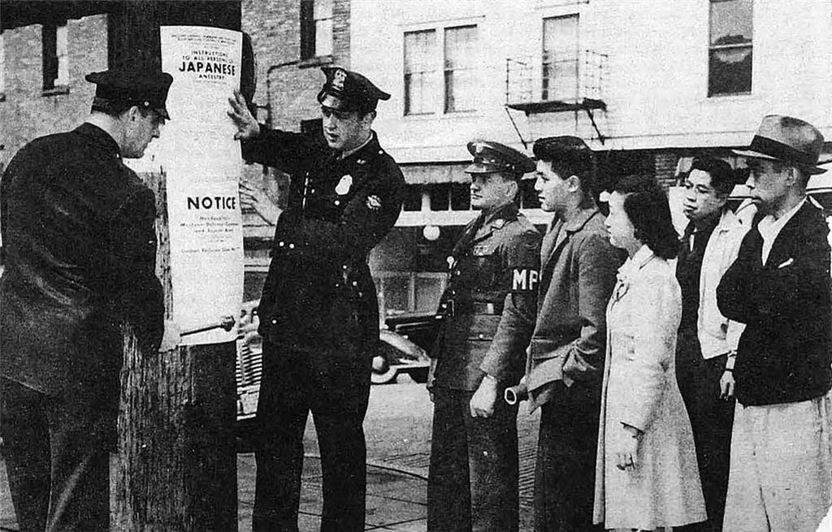
The Second World War and Japanese Internment
CORE
In May 1942 the United States government ordered every person of Japanese ancestry on the Eastside to leave their home.
Civilian Exclusion Order 80 ordered them to 122 Kirkland Avenue.
On 20 May 1942, 443 people boarded a train at the Kirkland station, a station that had not carried passengers in nearly twenty years. They were taken to a camp in California, and then to another.
This included people who had been born in the United States and were citizens. Most families never came back
Years later the United States formally acknowledged that this was wrong. Descendants of these families still live on the Eastside today.
23
Notes:
[CORE] · LESSON 2 · about 4 min
KEY POINTS
In May 1942 the United States government ordered every person of Japanese ancestry on the Eastside to leave their home. Civilian Exclusion Order 80 ordered them to 122 Kirkland Avenue.
On 20 May 1942, 443 people boarded a train at the Kirkland station — a station that had not carried passengers in nearly twenty years — to a camp in California, then another.
This included people born in the United States who were citizens. Most families never came back. Years later the United States formally acknowledged this was wrong. Descendants of these families still live on the Eastside today.
HOW TO TEACH IT
Three commitments make this teachable at this age. Name the actor: the United States government ordered families out of their homes; “families were removed” hides the government, and students notice passive voice when you point it out. Keep people whole: these are the same farming families from Lesson 1 — growers, organisers, neighbours with a co-operative and a packing shed — say so explicitly and go back to that slide if you can. Say what happened after: students need the whole arc, not only the injury.
Use “incarceration” as the primary term, per current scholarly and community practice; note that students may encounter “internment” elsewhere, including in this slide's title.
Sumie Akizuki wrote that the train passed her family's farm and her parents watched their strawberry fields until they could not see them any more. Read that aloud if it fits your room.
Some students may have family connections to this history. Do not call on any student as a representative of a group. If a student volunteers a family story, receive it as evidence and thank them.
ASK — AND LISTEN FOR
Q: Who ordered this? Who did it happen to?
Listen for: The United States government; neighbours, farmers, citizens, children.
Q: What did the families lose that a formal apology could not give back?
Listen for: Farms, homes, businesses, years, the community itself; most never returned.
STANDARDS · GRADE 4
H4.4.1, H2.4.2, C1.4.4, RCW 28A.345.130

Slide 24

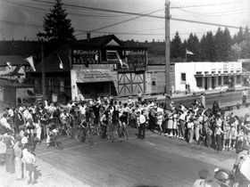
Spotlight: Derby Days
ADDITIONAL
At the end of the Depression, two Redmond newspaper boys raced their bicycles 26 miles around Lake Sammamish. People bet on the winning time, and the money bought Christmas decorations for downtown and sports equipment for the school.
THE MEN'S RACE
WHO STARTED THEM OFF
Won by Joe Richardson of Redmond in 1 hour, 30 minutes, 5 seconds. The prize was $25.
Mayor Bill Brown, the man who owned the saloon and the garage back in Lesson 1.
THE WOMEN'S RACE
AND THEN
Won by Eva Jean Prout of Kirkland in 1 hour, 46 minutes, 39 seconds.
No races from 1942 to 1945, because of the war. It has run every other year since, making it the oldest continuous bicycle race in the country.
24
Notes:
[ADDITIONAL] · LESSON 2 · +3 min if used
KEY POINTS
1939: two Redmond newspaper boys raced their bicycles 26 miles around Lake Sammamish. People bet on the winning time, and the money bought Christmas decorations for downtown and sports equipment for the school.
Men's race won by Joe Richardson of Redmond in 1 hour, 30 minutes, 5 seconds; the prize was $25. Women's race won by Eva Jean Prout of Kirkland in 1 hour, 46 minutes, 39 seconds.
Started by Mayor Bill Brown, the man who owned the saloon and the garage back in Lesson 1. No races from 1942 to 1945 because of the war; it has run continuously since, the oldest continuous bicycle race in the country (see the verification flag on the card's wording).
HOW TO TEACH IT
Technically droppable, but this is the most joyful slide in the unit and it is doing more real work than it looks like. It ties the cities together in a single event; it brings Bill Brown back as a person students already know; a girl won her race in 1939, which lands hard with students; and the four-year gap from 1942 to 1945 is the war, and the wartime shipyard is the very next slide. Let them notice the gap before you turn the page.
Ask them to guess how long 26 miles would take them, then give the times. Ninety minutes on a 1939 bicycle, on 1939 roads, is fast.
Derby Days is still held every July. The races moved off the lake loop long ago; in recent years they have been held at Marymoor Park and the Jerry Baker Memorial Velodrome.
ASK — AND LISTEN FOR
Q: How long would 26 miles around the lake take you?
Listen for: Guesses, then the times. Extension: how does a tradition last eighty-plus years? Has anyone taken part?
STANDARDS · GRADE 4
H2.4.2
VERIFY BEFORE PRESENTING
The slide's card says the race has run “every other year since,” which conflicts with “oldest continuous bicycle race” in the same sentence. Confirm the wording against the Redmond Historical Society's Derby Days history and correct the card before presenting.

Slide 25
LESSON 2 · CASE STUDY
Spotlight: Lake Washington Shipyard
CORE
IMAGE WILL GO HERE
Suggested: shipyard workers at Houghton, about 1943
8,000
men and women on three shifts by summer 1943, up from about 250 in 1939
29
warships built for the U.S. Navy, most of them seaplane tenders
nearly 500
battered ships repaired and sent back to sea
Lake Washington Shipyards, Houghton (Kirkland), 1941–1945
Kirkland Heritage Society · HistoryLink Essay 20514
The yard closed after the war. Carillon Point opened on the site in 1989.
WHO GOT THE JOBS
This is the Curtis family's boat landing from Lesson 1, now a Navy yard. Sixty women were in the sheet-metal shop by the end of 1942, and by the height of the war women worked in every trade. Black workers were kept out of most jobs by union rules and could not live in the federal housing built for shipyard families; the few who worked here commuted from Seattle.
DISCUSS The war ended in August 1945. One week later most of the swing shift was laid off. What happens to a town when the work disappears?
25
Notes:
[CORE] · LESSON 2 · about 3 min
KEY POINTS
The Curtis family's boat landing at Houghton (Lesson 1) became the Lake Washington Shipyards in 1923 and, from 1940, a Navy yard. Workforce: about 250 in 1939; more than 8,000 men and women on three shifts around the clock by summer 1943.
Output: 29 warships built for the U.S. Navy (most of them seaplane tenders) and nearly 500 other vessels repaired.
Who got the jobs: sixty women were in the sheet-metal shop by the end of 1942, and by the height of the war women worked in every trade. Black workers were kept out of most jobs by union rules and were not allowed to live in the federal housing built for shipyard families; the few who worked here commuted from Seattle.
After: one week after victory over Japan in August 1945, almost all of the swing shift was laid off. The yard closed; Carillon Point (offices, a hotel and a marina) opened on the site in 1989.
HOW TO TEACH IT
This is the slide the Lesson 2 title promised. Start from the Curtis landing: the same dock students met on the Early Families and Kirkland's Other Ventures slides in Lesson 1. Then read the three numbers aloud and put them next to Kirkland's pre-war population of about 2,000. Newly arrived families lived in garages, chicken coops, tents and shacks; a 1942 traffic count found 8,800 cars through downtown Kirkland in one morning.
The dark panel is what the Social Justice slide later in this lesson relies on: the war opened doors for some workers and kept them shut for others, and both happened in the same building. Say both halves.
The closing question is Monohon again in a different century: the mill burned and the town emptied; the yard's contracts ended and the shifts were cut. The difference is what came after — a business park and a marina, not a horse barn. Ask why.
ASK — AND LISTEN FOR
Q: The war ended in August 1945. One week later most of the swing shift was laid off. What happens to a town when the work disappears?
Listen for: People leave, or find other work; houses empty; the town has to reinvent the site. Compare Monohon. Why did Kirkland recover? Bridges, commuting, the lake, a growing region.
Q: Who was hired, and who was kept out?
Listen for: Women hired in every trade during the war (and mostly sent home after); Black workers excluded by union rules and from housing.
STANDARDS · GRADE 4
H2.4.2, H2.4.3, E4.4.2, RCW 28A.345.130
VERIFY BEFORE PRESENTING
Peak workforce: HistoryLink Essay 20514 and the Kirkland Heritage Society say about or more than 8,000 (summer 1943); Carillon Point's history page says nearly 9,000; a 2005 Seattle Times feature says 6,000. The slide uses 8,000.
Ship count: 29 built and nearly 500 repaired (HistoryLink); the Kirkland Heritage Society gives 477 repaired. No source supports escort carriers or destroyer tenders being built here; the yard's warships were seaplane tenders and net-laying ships.
Image placeholder: the Kirkland Heritage Society's Lake Washington Shipyards pages and HistoryLink Essay 20514 both carry period photographs; confirm educational-use rights before inserting.

Slide 26
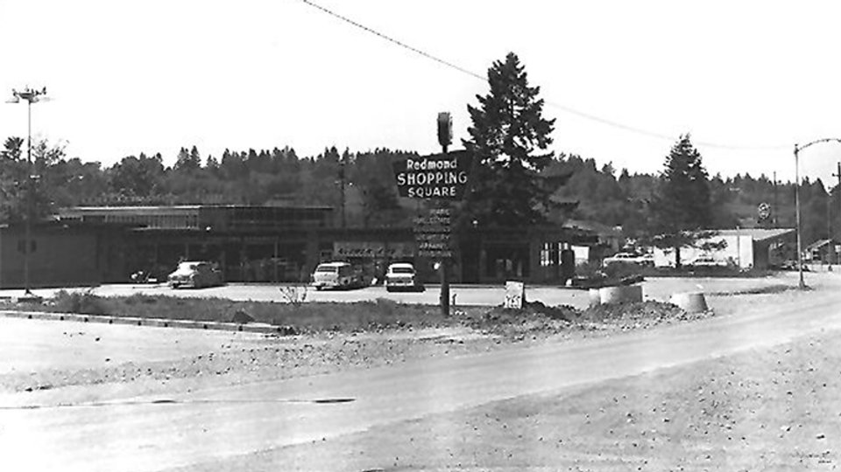
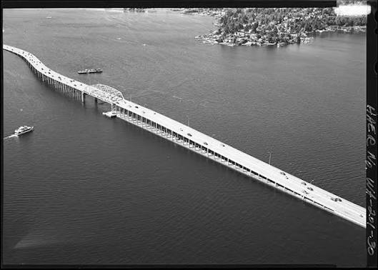
The towns start spreading
CORE
For almost forty years Redmond did not grow outward at all. From 1912 until 1951, the city limits never moved.
In 1951 Redmond annexed Education Hill, which nearly tripled the size of the city overnight.
Kirkland did the same thing: Houghton residents voted to merge with Kirkland in 1968, and Kirkland annexed most of Juanita and Rose Hill in 1988.
Bellevue incorporated in 1953 to get control of its own explosive postwar growth and became a popular commercial center
Improved Infrastructure: bridges across Lake Washington in 1940 and 1963 made it possible to work in Seattle and live here.
1940
First floating bridge across Lake Washington
1951
Redmond annexes Education Hill
1953
Bellevue incorporates
1963
Second bridge opens
1968
Houghton votes to merge with Kirkland
1988
Juanita and Rose Hill annexed
ASK If you lived just outside the city and it wanted to annex you, would you vote yes?
26
Notes:
[CORE] · LESSON 2 · about 2 min
KEY POINTS
For almost forty years Redmond did not grow outward at all: from 1912 until 1951 the city limits never moved. In 1951 Redmond annexed Education Hill, nearly tripling the city overnight.
Kirkland: Houghton residents voted to merge with Kirkland in 1968; Kirkland annexed most of Juanita and Rose Hill in 1988. Bellevue incorporated in 1953 to get control of its own explosive postwar growth.
Infrastructure: floating bridges across Lake Washington in 1940 and 1963 made it possible to work in Seattle and live here.
HOW TO TEACH IT
Annexing means a city adding nearby land to itself. The question on the slide is worth a real thirty seconds: you would gain city water and city fire service, and start paying city taxes and following city rules. There is no obviously right answer.
Bellevue's 1953 incorporation is the Bellevue thread's second appearance. Bellevue incorporated for a different reason than Kirkland or Redmond: not fire, not civic ambition, but growth arriving faster than the county could manage it. Four cities, four different reasons; Sammamish's is still to come.
The bridges are the quiet cause behind everything on the next few slides and behind the surprise on the population chart. Say the dates out loud: 1940 and 1963. Both are before Microsoft.
ASK — AND LISTEN FOR
Q: If you lived just outside the city and it wanted to annex you, would you vote yes?
Listen for: Yes: water, fire, sewers, a say in decisions. No: taxes, rules, losing rural character. Extension: a pretend annexation vote with two sides.
STANDARDS · GRADE 4
C2.4.1, H2.4.3

Slide 27
LESSON 2 · DATA
Redmond by the numbers
ADDITIONAL
Every ten years the United States counts everyone who lives here. This is what the count found in Redmond.
READ THE CHART
×7.7
the 1960s jump: 1,426 people in 1960, 11,020 in 1970
23,318
people already living here in 1980, six years before Microsoft arrived
1986
Microsoft moves to Redmond. The steepest climb on the chart came twenty years earlier
Source: U.S. Census Bureau, decennial counts. The city's boundaries grew in 1951, when Education Hill was annexed.
DISCUSS Most people guess Microsoft. Look at the 1960s. What else could explain the jump?
27
Notes:
[ADDITIONAL] · LESSON 2 · +3 min if used
KEY POINTS
Redmond's population at each U.S. Census: 1920, 438 · 1930, 460 · 1940, 530 · 1950, 573 · 1960, 1,426 · 1970, 11,020 · 1980, 23,318 · 1990, 35,800 · 2000, 45,256 · 2010, 54,144 · 2020, 73,256.
The steepest decade is the 1960s: the population multiplied by about 7.7 (1,426 to 11,020). By 1980 Redmond already had 23,318 people — six years before Microsoft moved to Redmond in 1986.
Part of the 1950–1970 jump is a boundary change: the 1951 annexation of Education Hill nearly tripled the city's area. Part is bridges (1940, 1963), postwar housing, and a state highway.
HOW TO TEACH IT
Check this against the chart-paper guesses from the start of the lesson. Most classes wrote Microsoft. Point at the 1960s and 1970s columns and let the room sit with it: the biggest change came before the software did.
Read the chart as a source, with the four questions: who made it (the Census Bureau), when (every ten years), why (to count people for representation and funding), can we trust it (mostly — but a boundary change changes what is being counted). The source line under the chart is there for that reason.
Then ask the discussion question and take three explanations. Bridges (1940, 1963) let people work in Seattle and live here; annexation (1951) put more houses inside the line; postwar families wanted new houses with yards; SR 520 (1963, extended to Redmond in 1981) made the commute ordinary.
ASK — AND LISTEN FOR
Q: Most people guess Microsoft. Look at the 1960s. What else could explain the jump?
Listen for: Bridges, annexation, new houses, the highway, families moving out of Seattle. Then: does the chart prove any of these? No — it shows when, not why. That takes other sources.
Q: Which column would look different if the city limits had never moved?
Listen for: 1960 onward; the 1951 annexation tripled the area being counted.
STANDARDS · GRADE 4
H2.4.3, SSS1.4.2
VERIFY BEFORE PRESENTING
Counts before 1920 (116 in 1900, 450 in 1910) are area counts from before incorporation and are omitted. The 1940 figure is 530 in the Census tables; the Redmond Historical Society gives 503.
The 'today' figure on Where we left off (80,280) is the Census Bureau's 2024 estimate; Washington OFM's April 2024 estimate is 80,040 and April 2025 is 82,380.

Slide 28
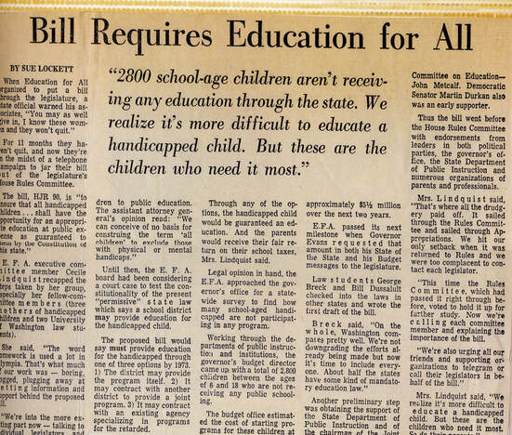
Social Change: House Bill 90
CORE
Four parents in Washington wrote a law saying every child with a disability had the right to go to public school. It passed that year.
BEFORE
HOW
Children with disabilities in Washington could be turned away from public school. No law said schools had to teach them.
With two law students, they wrote an actual bill and took it to Olympia themselves.
WHO
AFTER
Evelyn Chapman, Katie Dolan, Janet Taggart and Cecile Lindquist called themselves the Education for All Committee.
Washington passed its law four years before Congress passed one nationally. It is now chapter 28A.155 RCW.
28
Notes:
[CORE] · LESSON 2 · about 3 min
KEY POINTS
Before: children with disabilities in Washington could be turned away from public school; no law said schools had to teach them.
Who: Evelyn Chapman, Katie Dolan, Janet Taggart and Cecile Lindquist, four parents who called themselves the Education for All Committee. How: with two law students they wrote an actual bill and took it to Olympia themselves.
After: Washington passed its law in 1971, four years before Congress passed one nationally. It is now chapter 28A.155 RCW.
HOW TO TEACH IT
Two questions, in this order. “What did these parents have that let them change a law?” No office, no title, no money — organisation, persistence, and a written proposal. That is the pattern the unit keeps finding: the growers' association, the incorporation votes, and now four parents with a bill. Name the pattern out loud.
“Who does that law protect in this room?” Answer it honestly: it is why students with disabilities are in this classroom, and not somewhere else or nowhere.
Teach this in the third person, about named adults, as civil rights history. Do not turn to any student for confirmation or a personal example, and do not frame it as services being provided to people; frame it as rights being won by people. Washington marks a Disability History and Awareness Month in October; this is good material for it. Read the newspaper headline aloud.
ASK — AND LISTEN FOR
Q: What did these parents have that let them change a law?
Listen for: Organisation, persistence, a written bill, allies (two law students), a clear story. Not money, not office.
Q: Who does that law protect in this room?
Listen for: Everyone: it is why every student is here.
STANDARDS · GRADE 4
C4.4.2, H2.4.1

Slide 29
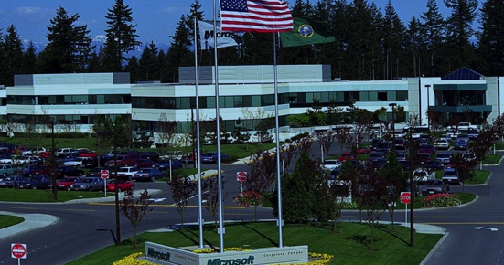
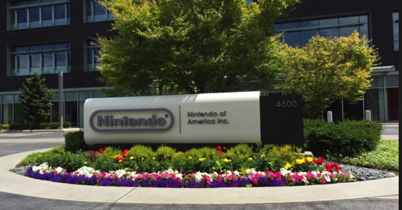
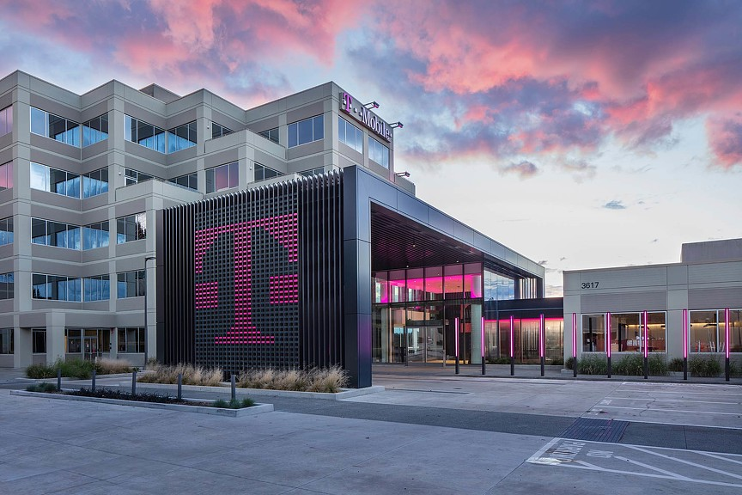
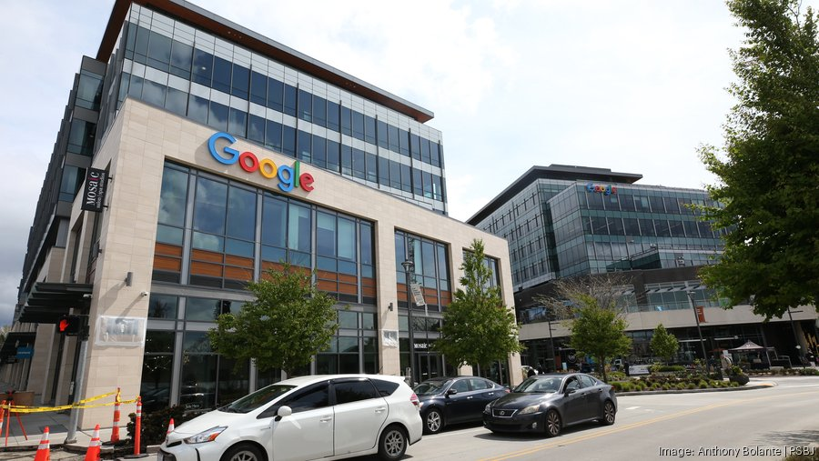
The Tech Boom
CORE
Technology is one of the biggest industries of the region
Google Offices, Kirkland
Microsoft's Redmond campus
Nintendo of America, Redmond since 1982
T-Mobile Headquarters, Bellevue
REDMOND
BELLEVUE
KIRKLAND
Microsoft moved in with six buildings and about 800 workers, on land that had been the Morelli family's chicken farm. Nintendo had already been here since 1982, and SpaceX builds satellites here now. In fact, Redmond is called a Space District!
Amazon was started in a rented Bellevue house, moved to Seattle, grew enormous, and then came back, announcing plans for 25,000 jobs downtown. T‑Mobile runs its national headquarters here too. The downtown area also welcomes new companies every year
Google opened a small office with a handful of engineers. It became one of the company's largest engineering sites outside California, and a new campus is reshaping downtown Kirkland. More companies, like the cybersecurity company Tanium call Kirkland home
DISCUSS Three of these cities got the tech jobs. But what about Sammamish?
29
Notes:
[CORE] · LESSON 2 · about 3 min
KEY POINTS
Redmond: Microsoft moved in (1986) with six buildings and about 800 workers, on land that had been the Morelli family's chicken farm. Nintendo of America had been here since 1982; SpaceX builds satellites here now.
Kirkland: Google opened a small office with a handful of engineers (2004) that became one of its largest engineering sites outside California; a new campus is reshaping downtown Kirkland.
Bellevue: Amazon started in a rented Bellevue house (1994), moved to Seattle, grew enormous, and came back with plans for 25,000 downtown jobs; T-Mobile's national headquarters is here.
Sammamish: none of the offices, all of the effects. Discussion: three of these cities got the tech jobs. What about Sammamish?
HOW TO TEACH IT
The framing that matters is the opening line. Students arrive believing “Microsoft happened and then everything changed.” The truth is messier and more useful: four cities, four decades, four companies, and every one started tiny. A chicken farm in 1986. A rented house in 1994. A handful of engineers in 2004. Ask which of those anyone could have predicted.
Sammamish is the card to slow down on. A city can be transformed by an industry that never builds anything there: Sammamish got the schools, the traffic, the house prices and the population without getting the offices. Expect answers like schools, roads, buses, parks, and somewhere for kids to go after school.
The chicken farm is the detail students remember, and it is the third time in this unit the same ground changed jobs: stumplands became farms, a shipyard became Carillon Point, and a chicken farm became a software campus. Make them name the other two.
One caution on the Amazon number: 25,000 was an announced plan, not a finished count. Check the current figure before teaching it. If a student asks whether it actually happened, that is a good moment to say that plans and outcomes are different things.
ASK — AND LISTEN FOR
Q: Three of these cities got the tech jobs. But what about Sammamish?
Listen for: Houses, traffic, schools, prices; the jobs are next door. Then: what does a city need when the jobs are next door?
Q: Name three places in this unit where the same ground changed jobs.
Listen for: Stumps → farms; shipyard → Carillon Point; chicken farm → Microsoft; McRedmond farm → Redmond Town Center.
STANDARDS · GRADE 4
H2.4.3, E4.4.2, E2.4.2
VERIFY BEFORE PRESENTING
Amazon's 25,000 Bellevue jobs was an announced plan; verify the current number before presenting.

Slide 30
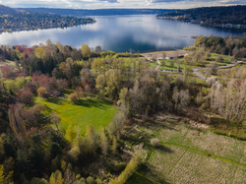
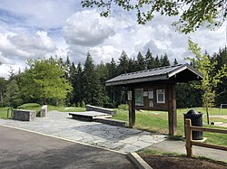
Sammamish Becomes a City
CORE
Sammamish stayed unincorporated for almost a century after Kirkland and Redmond, then voted to become a city on 31 August 1999.
For most of the twentieth century the plateau was chicken farms, dairy farms and lake resorts
By about 1984 the plateau had passed 10,000 residents, and people began arguing over whether to incorporate or be annexed by somebody else.
They argued about the name, too. Sahalee, Inglewood, Pine Lake, Timberline, Monohon, and Heaven were all names thrown in the pile.
1905
Kirkland incorporates
1912
Redmond incorporates
1953
Bellevue incorporates
1999
Sammamish incorporates
ASK Four cities, four different reasons to incorporate. What was Sammamish's?
30
Notes:
[CORE] · LESSON 2 · about 2 min
KEY POINTS
Sammamish stayed unincorporated for almost a century after Kirkland and Redmond, then voted to become a city on 31 August 1999.
For most of the twentieth century the plateau was chicken farms, dairy farms and lake resorts. By about 1984 it had passed 10,000 residents and people began arguing over whether to incorporate or be annexed by somebody else.
They argued about the name too: Sahalee, Inglewood, Pine Lake, Timberline, Monohon, and Heaven were all in the pile.
Timeline: Kirkland 1905, Redmond 1912, Bellevue 1953, Sammamish 1999.
HOW TO TEACH IT
Sammamish became a city more recently than many of your students' parents were born, which usually gets a reaction. It is a useful reminder that history includes last week.
The answer to the closing question is local control: residents wanted to decide for themselves how the plateau would grow, rather than have the county or a neighbouring city decide it. Put that beside the other three: Kirkland incorporated out of civic ambition after its mill failed, Redmond because it needed to borrow money for a water system after fires, Bellevue to manage postwar growth. Four cities, four problems, one tool. That completes the incorporation thread that started in Lesson 1.
Monohon on the shortlist of names is the payoff for planting Martin Monohon early. Pause and give them the chance to catch it, then point it out. Naming a place is a decision somebody makes, and it sticks: that connects straight back to the McRedmond and Perrigo naming fight.
ASK — AND LISTEN FOR
Q: Four cities, four different reasons to incorporate. What was Sammamish's?
Listen for: Local control: decide our own growth rather than be annexed or governed by the county.
Q: Which name would you have voted for, and what does a place name have to do?
Listen for: Any, with reasons: say where it is, honour someone, sound like home, be easy to say.
STANDARDS · GRADE 4
C2.4.1, H4.4.1

Slide 31
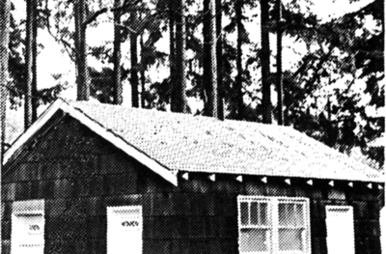
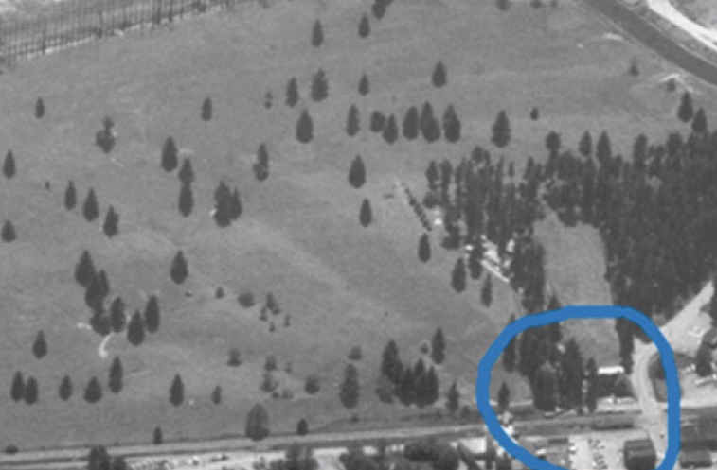
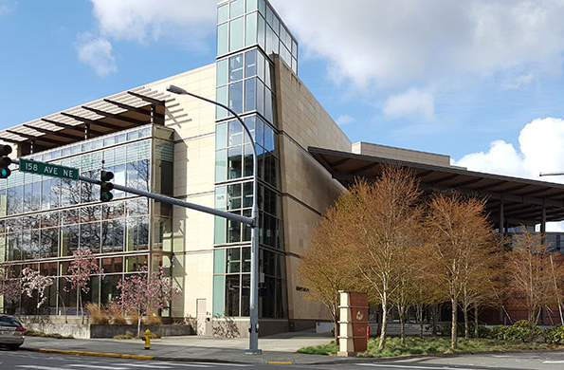
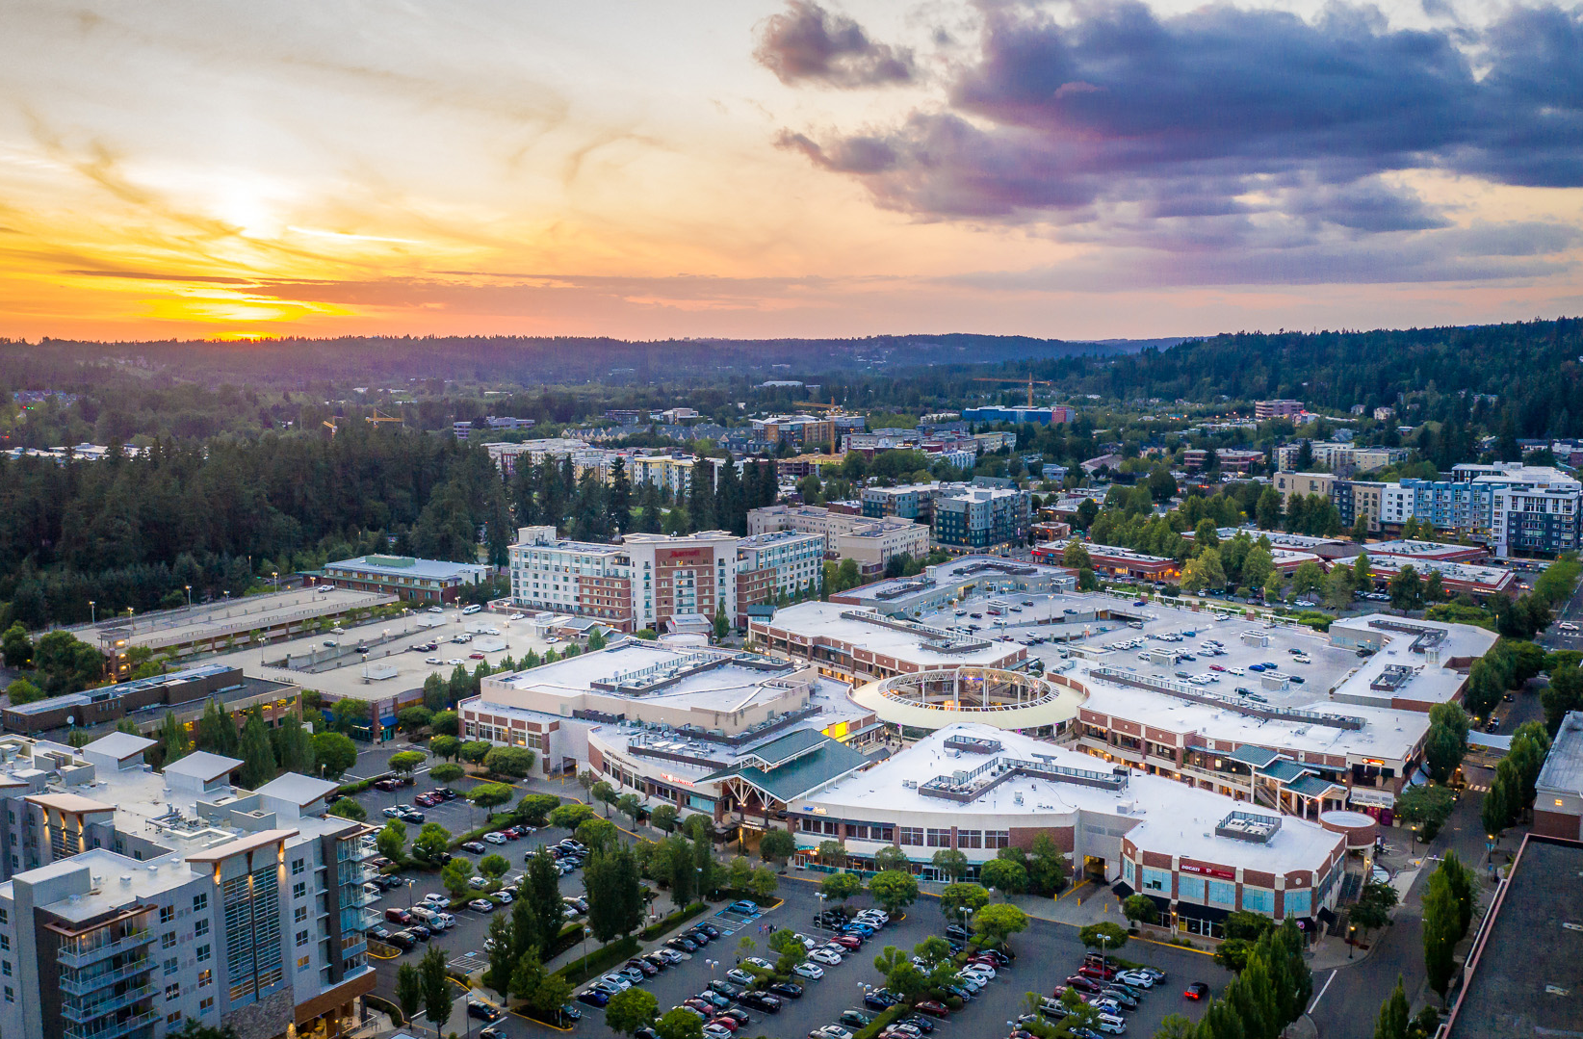
Infrastructure Development
Case Study: Redmond
CORE
WATER, 1912
Redmond incorporated partly so it could borrow money. After several bad fires, a bucket brigade was not enough. The town needed a bonded water system, something only cities could afford.
ROADS AND A BRIDGE
Trails became graded roads, and a bridge crossed the Sammamish River. Until then the river split the town in two and the railroad was the only reliable way out.
THEN · Bill Brown’s City Hall
THEN · the Redmond townsite from the air
STATE ROUTE 520, 1981
The highway was extended into Redmond. The city is now more accessible than ever
REDMOND TOWN CENTER, 1997
NOW · City Hall
NOW · downtown Redmond today
A shopping and office district was built on land the McRedmond family once farmed. Downtown Redmond moved and then filled in with apartments.
DISCUSS What feature of your city would you miss most if it disappeared today?
31
Notes:
[CORE] · LESSON 2 · about 2 min
KEY POINTS
Water, 1912: Redmond incorporated partly so it could borrow money; after several bad fires a bucket brigade was not enough, and only a city could afford a bonded water system.
Roads and a bridge: trails became graded roads and a bridge crossed the Sammamish River; until then the river split the town in two and the railroad was the only reliable way out.
State Route 520, 1981: the highway was extended into Redmond. Redmond Town Center, 1997: a shopping and office district on land the McRedmond family once farmed; downtown moved and then filled in with apartments.
Then and now: Bill Brown's City Hall and the townsite from the air; the 2008 City Hall and downtown today.
HOW TO TEACH IT
This is the responsibilities and powers of local government taught through what a city actually does once it exists. The fire thread from Lesson 1 ends here: Monohon burned in 1925, Redmond's hotel fires pushed the town toward incorporation in 1912, and incorporating is what let Redmond borrow money for a real water system. Fire shaped the government of this valley, and the water system is the proof.
SR 520 in 1981 is the quiet turning point. Ask students how their family gets to work and whether that road exists in the story yet.
Redmond Town Center on old McRedmond farmland is another example of the unit's central pattern: the same ground changing jobs. Handbook note: briefly mention the controversy about the town-centre development and why a suburban community might not want something like it.
ASK — AND LISTEN FOR
Q: What feature of your city would you miss most if it disappeared today?
Listen for: Water, roads, the bridge, the library, parks, the school; then: who pays for it and who decides?
STANDARDS · GRADE 4
C2.4.1, H2.4.3
VERIFY BEFORE PRESENTING
Captions to verify before presenting: the four photographs came into the deck without captions, so the wording is deliberately general. Confirm what each shows and its year, then tighten the captions and add a credit line.

Slide 32
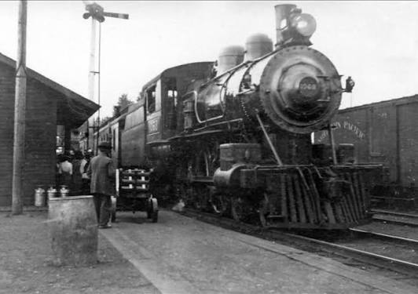
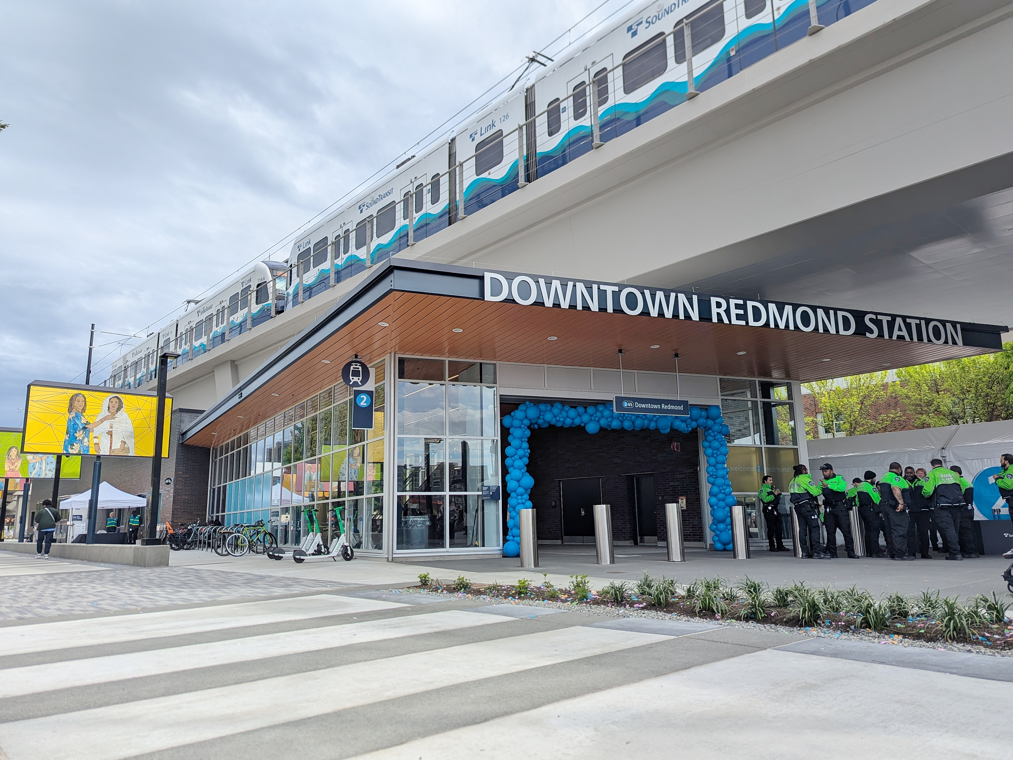
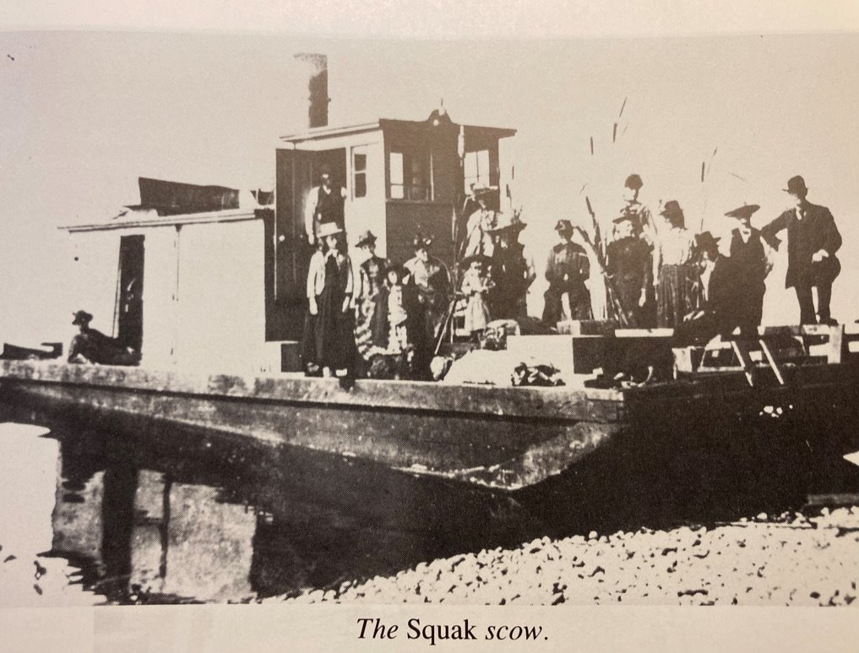
Infrastructure Developments: Transportation
CORE
There have been many recent developments in transportation in the area
Light rail reached Overlake in April 2024, downtown Redmond in May 2025, and crossed the lake to Seattle in March 2026.
The Kirkland station where families were forced onto a train in 1942 is part of that same rail corridor.
1880s
Railway makes timber sellable
1940 & 1963
Floating bridges
2024
Light rail reaches Overlake
2025
Downtown Redmond
2026
Across the lake to Seattle
Steamboats, then a railway, then bridges, then trains. Every one of them changed who could live here.
32
Notes:
[CORE] · LESSON 2 · about 2 min
KEY POINTS
Light rail reached Overlake in April 2024, downtown Redmond in May 2025, and crossed the lake to Seattle in March 2026.
The Kirkland station where families were forced onto a train in 1942 is part of that same rail corridor.
Timeline: 1880s railway makes timber sellable → 1940 and 1963 floating bridges → 2024, 2025, 2026 light rail. Steamboats, then a railway, then bridges, then trains: every one of them changed who could live here.
HOW TO TEACH IT
Bring the transportation thread full circle. In Lesson 1 the railway made timber sellable and let Emma McRedmond run a hotel beside the depot. Here the trains make the commute possible. Same valley, same logic: transportation decides who can afford to live somewhere.
The Kirkland station bullet is a hard, honest connection: the same corridor carried timber, then families to a camp, then commuters. Deliver it plainly and do not over-explain it. Students will sit with it.
Civic involvement is here too: voters approved the light-rail extension in 2008, and the first Eastside stations opened sixteen years later. People can vote on things whose effects arrive long after the vote.
ASK — AND LISTEN FOR
Q: Which of these changed who could live here the most?
Listen for: Any with a reason; bridges made the commute possible, rail made the timber town possible. Extension: what is the role of public transportation in the region now?
STANDARDS · GRADE 4
H2.4.3, C4.4.2

Slide 33
Social Justice and Equality in the Region
CORE
Activists have been fighting for equal rights for decades.
1942
Japanese American families — including United States citizens — were ordered out of their homes and onto a train.
1940s
Black workers were kept out of shipyard jobs by unions, and out of the housing built beside the yard.
1940s
Women were recruited to the yard at equal advertised pay but still had to fight to be accepted doing the work.
BEFORE 1971
Children with disabilities could simply be turned away from a Washington public school.
How was this change achieved? What can you do to help?
33
Notes:
[CORE] · LESSON 2 · about 3 min
KEY POINTS
1942: Japanese American families, including United States citizens, were ordered out of their homes and onto a train.
1940s: Black workers were kept out of shipyard jobs by unions, and out of the housing built beside the yard. Women were recruited to the yard at equal advertised pay but still had to fight to be accepted doing the work.
Before 1971: children with disabilities could simply be turned away from a Washington public school.
Question: how was this change achieved? What can you do to help?
HOW TO TEACH IT
This slide carries the unity-and-diversity standard, and the standard says describe and apply. Description alone is not the standard; the closing question is what makes students apply it.
It is also where Lesson 2 meets the inclusive-materials requirement, and it does so by putting four underrepresented groups into one frame students can reason about, rather than treating each as a separate sad episode dropped into the timeline. The shipyard slide earlier in this lesson gives the second and third rows their evidence.
Hold the closing question and make them answer it. The answer, every time, is people: parent committees, workers, lawmakers, voters, and families who refused to accept the boundary. That is the through-line into the closing activity.
Handle with care and do not call on any student as a representative of a group.
ASK — AND LISTEN FOR
Q: How was this change achieved?
Listen for: People organised, wrote, voted, sued, kept showing up: parents with a bill, workers with unions and lawsuits, citizens demanding an apology.
Q: What can you do to help?
Listen for: Learn the history, speak up when a rule is unfair, vote when you can, include people; concrete and small is fine.
STANDARDS · GRADE 4
C1.4.4, H4.4.1, SSS3.4.1, RCW 28A.345.130

Slide 34
LESSON 2 · CLOSING ACTIVITY · 20 MINUTES
Build a Mini-Museum
CORE
Your group is curating a small exhibit about ONE Eastside community. You get three objects and three cards. That is all the room you have.
1
PICK A CITY
2
PICK THREE THINGS
3
WRITE A CARD FOR EACH
4
Present!
Redmond, Kirkland, Bellevue or Sammamish. One city per group.
A building, a photograph, a person, a business, a law, a machine, etc.
Two to three sentences. Tell us all about it. Feel free to add a little picture.
Share the artifacts with your class
EVERY CARD MUST ANSWER THESE FOUR
AN EXAMPLE CARD
1 Who made this?
2 When was it made?
“The Redmond City Hall was built in 2008, and houses all of the government officers of Redmond. It replaced the initial rundown City Hall used by previous mayors and signalled a new age of development in Redmond.”
3 Why was it made?
4 How do we know we can trust it?
34
Notes:
[CORE] · LESSON 2 · about 20 min
KEY POINTS
Closing activity, twenty minutes: twelve to build, eight to present. Each group curates a small exhibit about one Eastside community with three objects and three cards. That is all the room they have.
Steps: pick a city (Redmond, Kirkland, Bellevue or Sammamish; one per group); pick three things (a building, a photograph, a person, a business, a law, a machine); write a two- to three-sentence card for each; present.
Every card must answer the four source questions: Who made this? When was it made? Why was it made? How do we know we can trust it?
HOW TO TEACH IT
This is the summative task for the whole unit and it is deliberately small: three objects forces choosing, and choosing is the assessment. What you are actually grading is the cards, not the objects. A group that picks three obvious buildings and writes four sharp cards has done better work than a group that picks clever objects and writes labels. The four source questions are the rubric, and they are the same four from the Lesson 1 photograph slide; students have practised this.
Push every group to include at least one object from the “we barely have” or “we almost lost” columns: the mill hands, the boarding-house keepers, the Japanese American farm families, the shipyard workers who were kept out. Expect groups to find this hard. That difficulty is the lesson: it is hard because the record is uneven, not because those people did not exist.
Ask every group after they present: what did you leave out, and why? There is no wrong answer, only an unexamined one.
Differentiation. Groups that finish early: write a fourth card for the object you decided to leave out, explaining why it did not make the cut. Groups that stall: give them a city and one object to start from. Students who find writing hard can dictate their cards to a partner; the thinking is in the four questions, not the handwriting. Laptops shorten research time but are not required.
ASK — AND LISTEN FOR
Q: What did you leave out, and why?
Listen for: Any reasoned answer; listen for whether the group noticed who is missing from the record.
STANDARDS · GRADE 4
SSS1.4.2, SSS3.4.1
MATERIALS
Index cards or half-sheets, one per object; poster paper if you want a display. Nothing needs printing in advance. Rubric in the companion document.

Slide 35
CORE
Works Cited
Every factual claim in this unit traces to one of these. Where two sources disagree, the slide says so.
HISTORYLINK.ORG
GOVERNMENT AND LEGAL SOURCES
Dougherty, Phil. “Redmond — Thumbnail History.” Essay 304.
City of Redmond. “City Landmarks.” City of Bellevue and City of Sammamish history pages.
Dougherty, Phil. “Monohon — Thumbnail History.” Essay 7780.
National Register of Historic Places. Peter Kirk Building listing, 1973.
Dougherty, Phil. “Monohon, Martin (1820–1914).” Essay 8375.
Washington State Law Library. “Special Education Law, Part One — History.”
Stein, Alan J. “Kirkland — Thumbnail History.” Essay 208.
RCW 28A.320.170; RCW 28A.345.130; chapter 28A.155 RCW.
“Sammamish — Thumbnail History.” Essay 10689.
OSPI. Since Time Immemorial curriculum.
“Lake Washington Shipyards (Kirkland).” Essay 20514.
U.S. Census Bureau and Washington Office of Financial Management. Population counts.
“Lake Washington Ship Canal.” Essays 686 and 1444; “Lake Washington.” Essay 20273.
City of Kirkland. Comprehensive Plan history appendix (Lorraine McConaghy).
HISTORICAL SOCIETIES AND MUSEUMS
NEWS AND REPORTING
Eastside Heritage Center. “Japanese Farmers in Bellevue, 1898–1942”; “Incarceration.”
The Seattle Times. Bear Creek excavation, 2008; Amazon's Bellevue expansion; Sound Transit East Link.
Kirkland Heritage Society. “Our History”; “On the Ways to Victory: The Lake Washington Shipyards.”
GeekWire. Amazon Bellevue job announcements; Google Kirkland campus.
Redmond Historical Society. “Derby Days History,” reprinting the Eastside Journal, 24 August 1939.
Redmond Reporter, 7 November 2016. Downtown landmark buildings.
Banel, Feliks. “Echoes of Eastside Rail History.” MyNorthwest, April 2024.
Sammamish Heritage Society. “Martin Monohon.”
Snoqualmie Tribe, Muckleshoot Indian Tribe and Tulalip Tribes. Public tribal materials.
Densho Digital Archive. Oral histories of the 1942 removal.
Image rights: photographs are used for classroom instruction only. Confirm educational-use rights with the holding institution before any reuse outside the classroom.
35
Notes:
[CORE] · LESSON 2 · not timed
KEY POINTS
Every factual claim in the unit traces to one of these sources. Where two sources disagree, the slide or the notes say so.
New sources added with this revision: HistoryLink essays on the Lake Washington Ship Canal and the 1916 lowering of the lake (686, 1444, 20273), and the City of Kirkland's comprehensive-plan history appendix (Lorraine McConaghy) for the shipyard.
Leave this projected while students write the citation lines for their cards or arguments.
HOW TO TEACH IT
This page replaces the source lines that used to sit at the foot of individual slides. It reads better, and it models what a citation page actually is: one place a reader can check everything, rather than a footnote nobody follows.
Where sources disagree — the Curtis landing date, the shipyard's worker count, Redmond's 1940 population, the Amazon job figure — the notes say so rather than picking one silently. Point that out to students at least once. It is what honest citation looks like.
If you add photographs to the deck, add the holding institution to this page and put a short credit under the image itself.
STANDARDS · GRADE 4
SSS1.4.2

